Slide 1
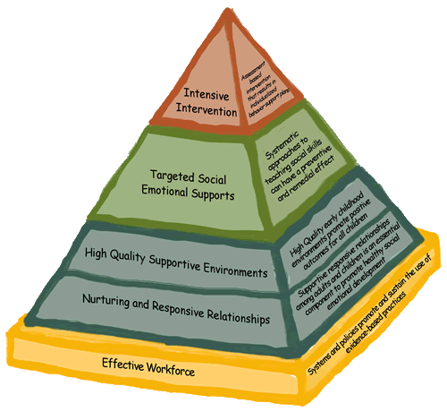


Foundations of the Pyramid Model in Primary Care
Notes:
Common focus: supporting children and families for better outcomes.

Slide 2
Welcome
Your trainers
  Emily Fischer
  Deborah Scannell
Who is in the audience today?
  Name
  Employment & Role
  What you hope to learn from this training
Notes:
Trainers introduce yourself to the group. Provide a brief overview of who you are, where you are from, and information about your background that is relevant to this training.

Slide 3
Agenda and Schedule
Day One
Introduction to the Pyramid Model (60 min.)
Social and Emotional Development in the Context of Relationships (120 min.)
Understanding Behavior: Making sense of what you see and hear (90 min)
Pyramid Model & Early Childhood System of Care Crosswalk (30 min.)

Slide 4
Objectives
Day 1
Participants will know the four levels of the Pyramid Model.
Participants will understand the elements of early childhood social emotional development.
Participants will identify communicative behaviors in infants, toddlers and young children.
Participants will describe how the Pyramid Model Framework informs planning and implementation approaches for supporting social emotional development in young children in primary care

Slide 5

The Words We Will Use
  Caregiving
  Young Children, Infants, Toddlers, Preschoolers
  Caregivers
  Families
  Teaching and Supporting
  Primary Care
  Medical Home
  Behavioral Health Integration
  System of Care
Notes:
Discuss with participants the key words that have been chosen and will be shared and used at different points throughout the training session.
• Caregiving: The practices caregivers use to identify strengths in young children’s families as they create supportive environments and help to nurture and support the growth and development of young children socially and emotionally.
• Young Children, Infants, Toddlers and Preschoolers: “Young children” generally refers to infants toddlers and preschoolers; however, there will be times that we specifically reference and talk about a particular age range such as infants, toddlers or preschoolers.
• Caregivers: “Caregivers” refers to a general category of ALL the adults who support the growth and development of young children (e.g., childcare providers, parents, extended families, guardians, teachers, home visitors, public health professionals).
• Families: “Families” represents those primary, significant, familiar, caring adults in the young childʼs life.
• Teaching and Supporting: The significant role of the adult caregiver is referenced differently nation wide teachers, care teachers, early learning caregivers, etc. Whether using “teaching” or “supporting,” we are referring to the responsibility of the adult to observe and reflect on what infants/toddlers and young children are experiencing and how they learn, as well as how to support this learning through consistent, responsive interactions (e.g., ways they care for infants, read cues, meet their needs, etc.) and their relationship with the child and family. It is about facilitating development or in other words, supporting growth and development. As caregivers observe and think about what they see and hear they can plan for and design experiences in an environment that contributes to a childʼs success.
When we refer to “teaching and supporting” we also mean individualized approaches that “meet” the young child where he or she is developmentally.
Primary care refers to the settings that families access for their children’s medical care. In this context, most primary care settings are Health Centers, with an interdisciplinary team of NPs, MDs, Mas/CAs, RNs, and sometimes case managers and social workers.
The term medical home refers to a primary care setting that acts as a hub for the multitude of health, mental health, and psychosocial needs any given individual or family may need. A medical home is a philosophy of care that is “patient-centered, team-based, comprehensive, coordinated, accessible, and focused on improving quality and safety”.
Behavioral health integration is the term used to describe the growing movement to integrate mental health care into primary care settings. This comes out of an acknowledgment that mental health is a crucial part of overall health that has historically been poorly integrated into primary care. There are various levels of BH integration, from simply referral partnerships to co-location to full integration (where systems and sites are shared).
System of care refers to “a network of strong, coordinated, and responsive organizations” that focus on care for a certain population. In our case, we are focused on building systems of care for young children and their families.

Slide 6
Why the Pyramid Model?
Grounded in a Public Health model: promotion, prevention, and targeted intervention
Provides a compilation of Evidence-based Practices
Supports building Systems of Care at the local, state, & national level
  In use in a variety of settings already, including Head Start, Early Care and Education, Inclusive Preschool, Early Intervention, Family Support programs, & Home Visiting
  Aligns with Positive Behavior Intervention & Support (PBIS) in Schools
  ECMH Consultation frame for EEC and HS SE Guidelines
Open source materials: it’s all free and available on line!
Notes:
A conceptual model of competences and practices
Opportunities to help all children practice social emotional skills

Slide 7
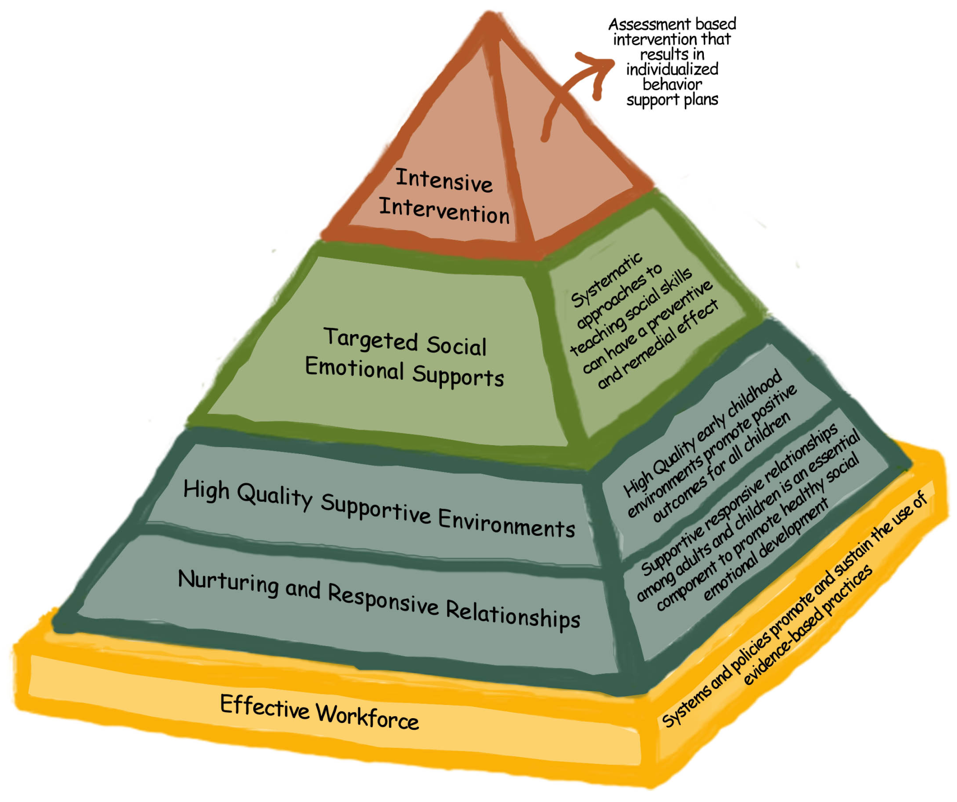
Few children
Children at-risk
All Children
Notes:
7
Explain each tier (transcript) or 11 min TACSEI video
Handout: Pyramid Article
7

Slide 8
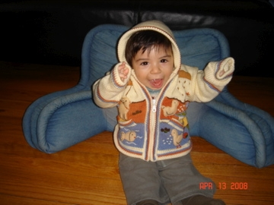
Key Points about the Center on the Social Emotional Foundations for Early Learning (CSEFEL) Pyramid Model
Most social/emotional development and behavior is promoted through positive preventive measures
Most children’s behavior and development does not require intensive intervention
Shared by Miriam Santiago
Notes:
Good news! If the bottom of the Pyramid is in place, only a small percentage of children rise to the top of the Pyramid.
Today we will discuss social-emotional development and why it is important, define social emotional development of young children, and review social emotional milestones. We also highlight the need to engage parents to observe their young children and families. Through parent engagement, we learn a better understanding of a young child's temperament and supportive ways to respond. Each of these concepts will contribute to a more complete understanding of a young child's strengths and possible areas of need.

Slide 9
The Pyramid aims to promote children’s success by….
Creating environments where EVERY child feels nurtured and supported, whether at school, at home or in a provider’s office;
Designing environments that promote child and family engagement;
Supporting caregivers to actively teach children social-emotional skills, such as:
  Teaching expectations and routines, and
  Teaching skills that children can use in place of challenging behaviors.
Notes:
There are a variety of things we can do to prevent challenging behaviors and to teach children appropriate behaviors.
As adults, we must first focus on prevention before we focus on changing children’s inappropriate behaviors.
The Pyramid is the framework or core concept from which all the training content has been built.
The Pyramid is a model that represents components of adult behavior and strategies that parents, caregivers, teachers, and other professionals can use to assist children in developing social emotional competence.
Along with learning about early childhood development and how to better understand individual children, the Pyramid modules offer strategies for creating group care environments and practices that promote social emotional development, working with families to support the well-being of very young children, and using a problem-solving approach when a behavior is of concern.

Slide 10

Applying the Pyramid Model in Primary Care
The pyramid model:
Gives teams an opportunity to clarify which parts of the pyramid are strong and which parts need development
Provides a framework for describing some of the work we are already doing (helpful for sustainability!)
Provides evidence for the need for building bottom-of-the-pyramid supports (sometimes challenging given MH billing structure)

Slide 11

Discussion Question
Think about your practice setting. Is the bottom of the Pyramid in place? What evidence do you have?
Notes:
Large grp. activity
Assessment – A question to ask the team, “Is the bottom part of the pyramid in place”?

Slide 12

Pyramid Model in Massachusetts
Training with Target Audiences
Infant/Toddler and Preschool Modules
Early Education & Care, Public Preschool Special Education, Early Intervention Practitioners
Foundations of the CSEFEL Pyramid Model
Mental Health Consultant, Early Education Administrator & Teacher Teams
Top of the Pyramid Skills (TOPS)
Parents Interacting with Infants (PIWI)
Early Intervention, Mental Health Consultants, Family Support, Home Visiting, Primary Care Behavioral Health Integration Teams
CSEFEL Family Modules
Shelter staff: Administrators, Floor Staff & Mental Health Clinicians
Positive Solutions for Powerful Family Interactions
ECE Program Teams implementing to fidelity
Adopting the Pyramid Model Program-Wide
Mental Health Clinicians & Administrators
CSEFEL Coach's Training
Teaching staff at 2 & 4 year institutions
CSEFEL Higher Ed Institute
Notes:
In primary care you will engage with children and families who may need other supportive services. You may engage with community members who are also implementing Pyramid Model practices when serving children and families. As you can see from the slide, the Pyramid Model is being implemented by adults who work with children and families across the state.
Handout: PMLC Schedule & reg. info, MA Pyramid Web site.

Slide 13
Each Learner Brings their Own
Approach which Balances:
Personal Experience
Prior Training/Academic
Work Experience
Notes:
Acknowledge multi - disciplinary audience
An effective working team listens to and values others.
Equal pieces of the pie.

Slide 14
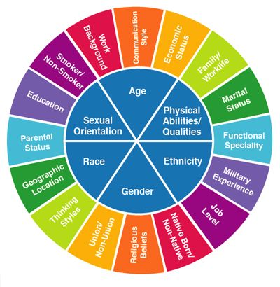
Each of us relates to learning and practice from the unique perspective of our own social identities:
As we learn together, we invite you to name the particular social identities that inform your perspective.

Slide 15
Or Head, Heart, Hands
Head:
Knowledge, information,
understanding
Heart: Feelings, values, beliefs, preconceptions
Hands: Skills, tools, strategies
Notes:
We approach this work knowing our preferences and implicit bias.
Ask audience what this slide means to them
What does this slide mean when working with children, families and peers and administration.

Slide 16


Talk to a peer about your learning style…
Visual
Auditory
Print
Haptic/Tactile
Interactive
Kinesthetic
Olfactory
Notes:
We all come to a training with different strengths and needs. Understanding learning styles is very important in our work.
Partner Activity: Working with a partner, Identify your style. Is it the same for every activity?
In your work, why is it important to know this. As a learner, as a teacher of new skills, as a parent.
Discuss findings

Slide 17

Why Focus on Social Emotional Development
Notes:
Ask participants, “Why focus on social emotional development of young children? ”Elicit responses from the group.
Consider ways to highlight the feedback and responses shared, such as repeating the statements offered or noting responses on chart paper.
Possible responses may include:
• Social and emotional development not only impacts all other areas of growth and development, it is the foundation upon which all future development is built.
• What caregivers share with and give infants and toddlers today, they will carry inside themselves forever. • Social and emotional development sets the“ playing field” for school readiness and life long success. Research shows that children who have healthy social and emotional skills tend to learn better, are more likely to stay in school, and will be better able to make and keep life long friends.

Slide 18
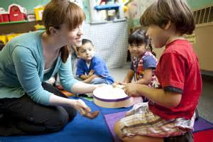
Social Emotional Development
Notes:
The number one indicator of school readiness is social emotional well-being

Slide 19

Activity: ABCs of
Social Emotional Development
Using a blank piece of paper, write the alphabet down the left hand side
Think about your own social emotional skills and strengths, as well as social emotional skills you want to see and help support in the children you work with
In 2 minutes, brainstorm a list of words you are thinking about using each letter of the alphabet
Notes:
Individual Activity: ABCs of Social Emotional Development
Instructions:
• Using a blank piece of paper, write the alphabet down the left hand side
• Think about your own social emotional skills and strengths, as well as social emotional skills you want to see and help support in the children and families you work with
• In 2 minutes, brainstorm a list of words you are thinking about using each letter of the alphabet
Trainer’s Note: As you describe the steps for this activity, consider offering a few examples of social emotional skills and strengths to participants.
Some examples might be
S=self-awareness
U=understanding feelings
M=mood management
I=impulse control
E=empathy
F=friendship making
P=problem solving
Or C=cooperation.
Once finished, ask for some examples from various letters of the alphabet of responses from the larger group.

Slide 20
CSEFEL Definition of Social Emotional Development
The term social emotional development refers to the developing capacity of the child from birth through five years of age to form close and secure adult and peer relationships; experience, regulate, and express emotions in socially and culturally appropriate ways; and explore the environment and learn - all in the context of family, community, and culture.
Caregivers promote healthy development by working to support social emotional wellness in all young children, and make every effort to prevent the occurrence or escalation of social emotional problems in children at-risk, identifying and working to remediate problems that surface, and, when necessary, referring children and their families to appropriate services.
(Adapted from ZERO TO THREE, 2001)
Notes:
The Center for Social Emotional Foundations for Early Learning, CSEFEL adapted with permission from ZERO TO THREE's definition of infant mental health this definition.
Ask participants to read through the first paragraph and second paragraph.
Point out that what is described in these paragraphs boils down to this:
Healthy social emotional development grows from relationships between children and their caregivers.
Social emotional development begins at birth and continues throughout life.
It provides a foundation for meaningful relationships and learning.
When children experience difficulty in acquiring social emotional skills, they are at increased risk emotionally, developmentally, and academically.

Slide 21

Major Elements of Social Emotional Wellness for
Young Children
The developing capacity
of the child from birth
through five to…
Form close and secure relationships
Experience, express, and regulate emotions
Explore the environment and learn
Notes:
Three major elements of social emotional wellness in infants, toddlers, and preschoolers: experiencing, expressing and regulating emotions; forming close and secure relationships; and possessing the ability to explore and learn. As you know the last two bullets tell us how children learn by exploring their environment in the context of family, community, and culture.
By focusing on social-emotional development through strengthening the parent-child interaction, then we are supporting the child’s readiness to learn and the parent’s ability to support them. To accomplish this we need to focus on ways of interacting with parents that builds the parents skills to support their child through the day.
21

Slide 22
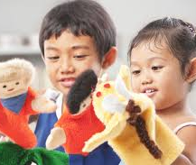
Key Social Emotional Skills Children
Need as They Enter School
Confidence
Capacity to develop good relationships with peers and adults
Concentration and persistence on challenging tasks
Ability to effectively communicate emotions
Ability to listen to instructions and be attentive
Ability to solve social problems
Notes:
Describe how several national reports (e.g., Eager to Learn, Neurons to Neighborhoods, A Good Beginning, the Kaufmann Report on Social-Emotional Development) have discussed the importance of social emotional development in children’s readiness for and success in school. These publications have identified a number of social emotional skills that help children be successful as they transition into kindergarten.
These skills include: read slide bullets
• Confidence • Capacity to develop relationships with peers and adults • Concentration and persistence on challenging tasks • Ability to effectively communicate emotions • Ability to listen to instructions and be attentive • Ability to solve social problems
Ask participants to explain how they know when a child doesn’t have a specific skill (e.g., for example, “What do children do when they can’t persist at a challenging task and they are faced with something that is hard for them?”).
22

Slide 23
When children do not have these skills, they often exhibit challenging behaviors.
Our focus is on promoting children’s ability to learn these skills with the support of their caregivers.
Notes:
Make the point that children often use challenging behavior when they don’t have more appropriate behaviors or skills to accomplish the same goal or to communicate the same message. This means that our focus has to be on “teaching children new skills” rather than “trying to get them to stop using challenging behaviors.” We need to teach children what to do rather than what not to do. Make the point that this also applies to children who speak another language or whose home culture values different behaviors than the early childhood setting (e.g., home culture might value listening to adults during mealtime versus engaging in conversation while one eats). The goal is to facilitate children’s learning of skills valued in the school/community in order to ensure success while at the same time honoring the values and beliefs of the home culture and language.

Slide 24

Vignette
Three year old Mariely was referred to the LAUNCH clinician in her clinic. Her parents had recently separated, and Mariely was having tantrums every time she transitioned their houses. The clinician helped the family write a social story that validated Mariely’s feelings of sadness, confusion, and anger, while also helping her understand what things would be like for her family going forward. The book also included strategies for what she could do when she got upset. During a visit, the clinician made a Glitter Jar for self-regulation with Mariely and her mom. Mariely’s mom said she watched her daughter go into her room and shake the jar after she got upset.

Slide 25
How Can We Get There?
Capacity to:
Feel confidence/ competence
Develop relationships
Make friends
Persist
Follow directions
Be emotionally literate
Manage emotions
Be empathetic
Capacity to:
Form relationships
Express emotions
Self-regulate
Explore with security
Develop “emergent” emotional literacy
Birth
Five
Notes:
Another way of thinking about the development of social emotional skills early in life and its progression. Share the following points with participants:
In the earliest years of life, we are laying the foundation for a child's social emotional development which will impact his/her experiences and learning during the course of his/her life.
Learning begins well before kindergarten. For example, when a very young child experiences relationships and learns to express emotions he is later better able to develop friendships with peers. Or, when an infant feels secure in her surroundings and experiences the excitement of discovery, she is later able to feel confident about learning. She then is likely to persist in the face of new challenges.
Achievement of early social emotional skills and milestones are linked to positive early childhood mental health, continued skill development and school success

Slide 26
What Helps Us Get There
One-on-one time
Play
Quick and predictable responses
Cuddling and gentle touch
Routines that establish patterns of caring response
Talking
Reading and singing
Notes:
What Helps Us Get There?
We've talked about what social emotional development is and how it develops as a progression but what can we do to ensure that the skills develop appropriately?
Meaningful interactions that caregivers, professionals, and other adults have with young children during every day moments provide natural opportunities to shape social emotional development.
Ask participants what they think of the second bullet. Not only is it important to play with children and take their lead, it is also important to be “playful”.

Slide 27


LUNCH
One Hour

Slide 28
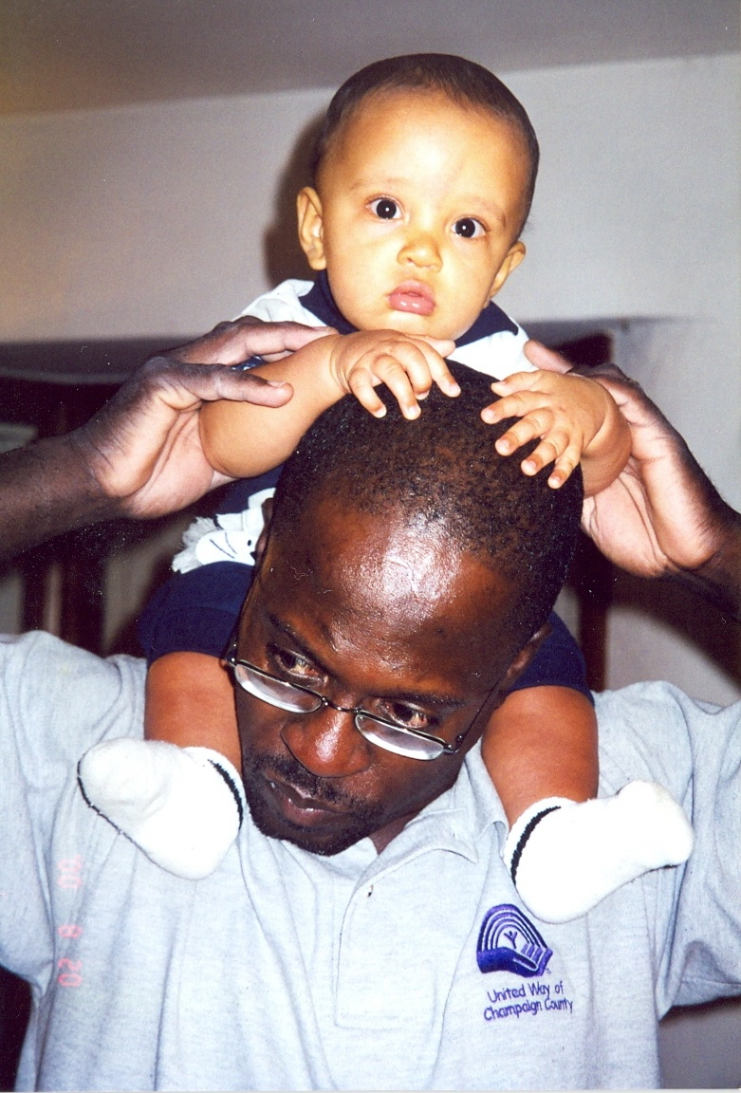
Key Findings on Social Emotional Health and Early Brain Development
Notes:
Activity: Key Findings on Social Emotional Health and Early Brain Development.
Trainer’s Note: Use Handout 1.8 as a way to enhance participants' understanding and linkages between social emotional and brain development, as well as identify key research findings.
An answer sheet for trainers is provided on the second page of Handout1.8.
Say to participants, “Before understanding and learning even more ways we can influence and support children's social emotional development and early learning, it's useful to know some of the impressive discoveries about early brain development that have led to a particular focus on important interactions such as gentle touch, play, rocking, singing and reading.” Clarify that each of the statements is formatted as true/false and demonstrates research findings on early social emotional and brain development. Several national reports and multiple publications discuss these early capacities (e.g., From Neurons to Neighborhoods: The science of early childhood development, 2001 and Emotional Connections: How relationships guide early learning, 2003).
Each finding is evidence of the amazing capacity of babies to seek out and develop relationships with other human beings.

Slide 29
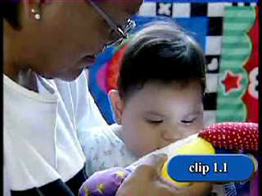
Caregivers Supporting
Social Emotional Development
Notes:
Video 1.1
Explain that sometimes a picture may be worth a thousand words and seeing it in action may be worth
Even more. Tell participants that they will be viewing two video clips (one right after the other) of caregivers interacting with young children. Ask participants to think about the definition of social emotional development that was just discussed and identify what each of these caregivers is doing to promote social emotional development.

Slide 30
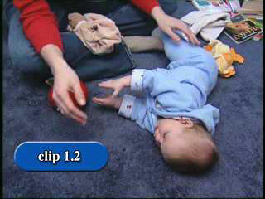
Video 1.2 Supporting
Self- Regulation
Notes:
Video Clip 1.2 Supporting Self Regulation.
Let participants know they will be viewing another video clip which shows an adult caregiver supporting a young child's (7months of age) social emotional development, specifically self-regulation.
Ask participants to observe and think about the following while viewing the video clip:
• What did you see the baby doing?
• What did you see the caregiver doing to help the infant regulate himself?
• Were the caregiver's efforts successful?
Trainer’s Note: If time allows, show the clip a few times to see if through multiple observations participants are able to notice more behaviors. Consider having part of the group observe the care giver and part of the group observe the young child.
Note that how the young child feels and how the caregiver feels may likely contribute to their positive behavior.
Highlight the following pieces of information:
Self-regulation is a fundamental aspect of emotional development and influences children's social competence and success in school.
Self regulation is a child's ability to gain control of bodily functions, manage powerful emotions, and maintain focus and attention.
From the work of (Shonkoff & Phillips(2000),Neurons to Neighborhoods: The Science of Early Childhood Development.)
Self-regulation develops overtime.
Adult caregivers are responsible for maintaining and supporting an infants regulation. When caring for an infant, toddler, and young children, caregivers and families act as extensions of supports for the child's internal ability to regulate. When adults remove a layer of clothing for an infant who appears warm, offer an infant a pacifier, provide a soft blanket for a toddler who is being rocked and getting ready for nap time, validate a toddler's extreme frustration, or provide consistent, supportive routines they are helping the child to regulate his/her emotions and internal states. Infants begin to learn ways to self-soothe their own distress first by being soothed when their needs are met by another.

Slide 31
The Developing Brain – Essential Needs
Healthy Relationships - early relationships are vital to brain development because they help wire the brain to trust others, to love, and to feel safe and secure.
Positive Experiences - new brain connections are formed and modified through verbal and physical interactions
Consistent and Secure Environment - the brain develops gradually in response to experience and to the environment
Notes:
The Developing Brain – Essential Needs.
Ask participants, “Did you know that by providing this kind of responsive caregiving and by promoting social emotional development in this way you are also helping to build and shape the architecture of a young child's brain?”
A newborn's brain contains about100billionbrain cells, or neurons, and through out the first year of life, many more connections (synapses) between these brain cells are produced. It is during the first three years of life that most of these connections are made (Gabbard,1998).
A newbornʼs brain is only about one-quarter the size of an adult's. Before a child's second birthday, the brain will have developed up to three-fourths adult size and will be almost at its adult weight and volume (ninety percent) by age five. It does not mean that ninety percent of the information a person will ever know is learned in the first five years–far from it. It means that in these earliest years, the way information flows through the brain's structures and gets processed is largely established. These brain connections, pathways and structures will be used and reused as learning continues throughout life.
Share the following points as away to summarize the previous slides and new information discussed:
Scientists have recently learned even more about how important these early interactions and experiences are to childrenʼs early brain development and learning.
It is brain development that allows children to be able to crawl, laugh, speak, eat, etc. It is also brain development that allows children to be able to listen, concentrate, control oneʼs impulses, problem solve, etc.
New connections are formed through interactions young children have with their families and caregivers. For example, when a baby cries and is picked up, a connection is made: When I do this, this happens. Each time you pat a babyʼs back, feed her, or walk into a new place, new connections are made.
A two-year-oldʼs brain uses up twice as much energy as a typical adult brain. The work/development of infants and toddlers is exhausting. This is one reason it is critical that infants and toddlers get plenty of sleep. Plenty of sleep helps build and solidify the brain connections.
Ask participants, “How does your care influence a childʼs brain? What brain connections will be made as a result of your care?”
Elicit responses such as:
• Providing responsive care leads to babies believing
• Developing a positive relationship with a child will teach the child how to engage in positive relationships. The child will learn how positive relationships feel.
• Being attentive will help a child feel he is worthy of receiving care and attention.
• Listening to a child will encourage her to communicate strengthening her ability to express herself.

Slide 32
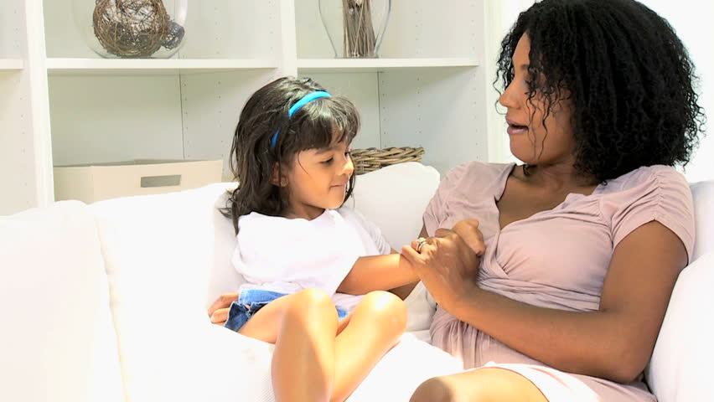
Making Every Day Count: Ways to Help Build Brain Connections
Create a photo album
Hold and touch young children gently – offer gentle caresses
Use a warm and encouraging tone of voice
Talk, sing and read books
Play games with hands
What special hands games did you play as a child?
Notes:
Point out that together we have discussed how our care can shape the brain. What specifically can we do to build those connections?
Review the strategies noted with participants. Offer the following supportive information for each bulleted item.
These activities also help young children learn about language. Most young children love to repeat familiar songs and stories. Repetition is
Important to learning. Each time a young child hears a repeated pattern, that pattern becomes stronger. Each repetition results in stronger memory. Games like pat-a-cake offer opportunities for social interaction, imitation and touch. This interaction combines smiles, eye contact and voice which enhance relationships and support the brainʼs ability to focus.

Slide 33
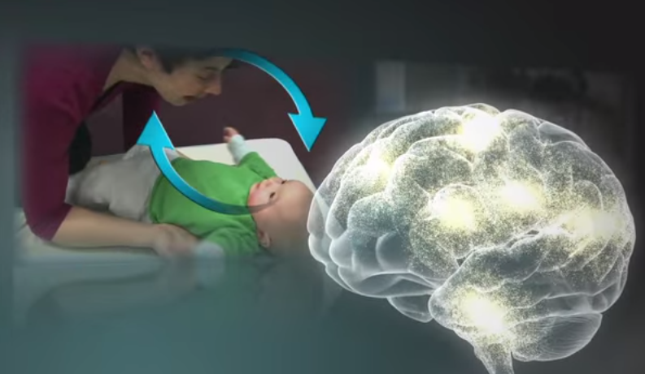
Serve and Return
Notes:
Video
Serve and return interactions shape brain architecture. When an infant or young child babbles, gestures, or cries, and an adult responds appropriately with eye contact, words, or a hug, neural connections are built and strengthened in the child’s brain that support the development of communication and social skills. Much like a lively game of tennis, volleyball, or Ping-Pong, this back-and-forth is both fun and capacity-building. When caregivers are sensitive and responsive to a young child’s signals and needs, they provide an environment rich in serve and return experiences.

Slide 34
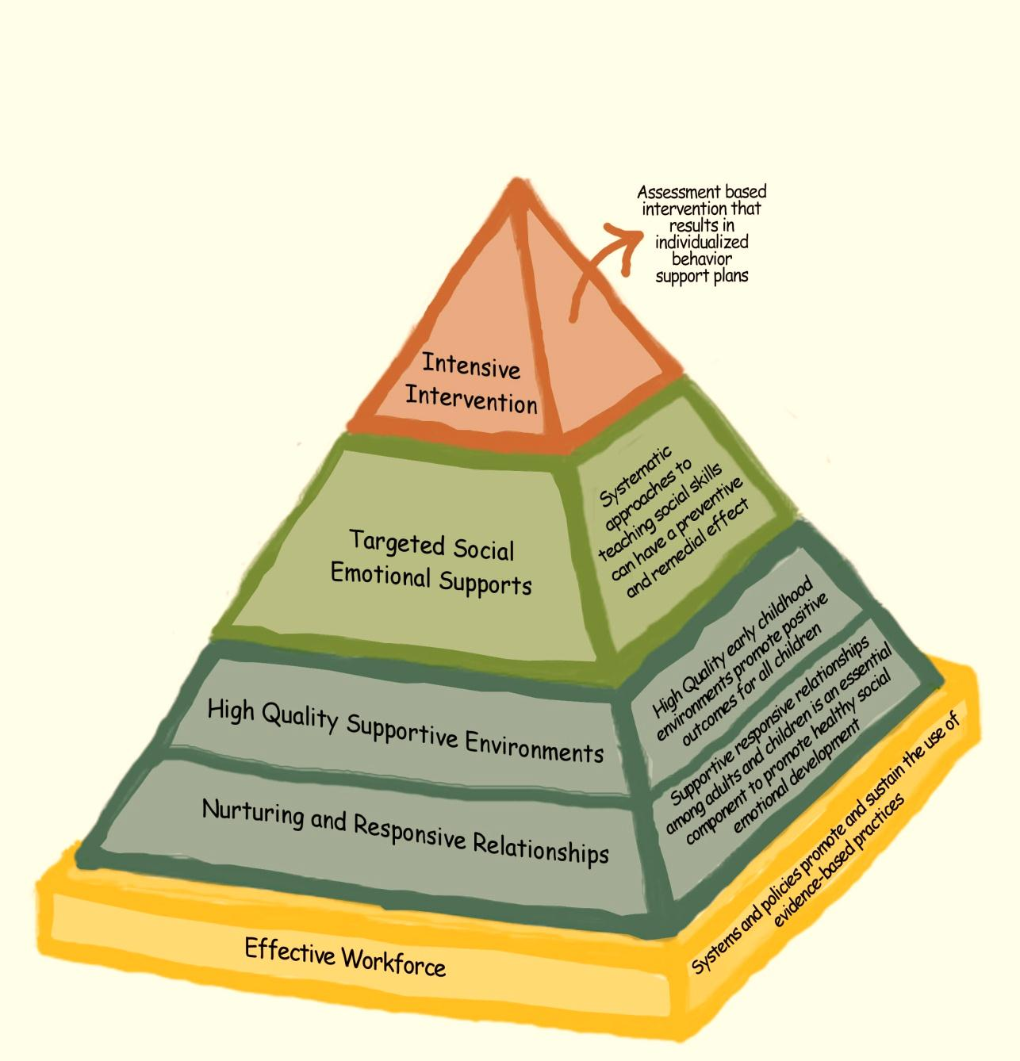
Relationships:
The Foundation of the Pyramid
Notes:
Strong relationships form the foundation of the Pyramid Model and are necessary for everything else caregivers do with young children. ! It is within families and caregiving relationships that children learn to experience and communicate emotion
34

Slide 35
Building Relationships
Children with the most challenging behaviors especially need these relationships, and yet their behaviors often prevent them from benefiting from those relationships.
Adults’ time and attention are very important to children, and we need to be sure that we are giving them that time and attention at times other than when they are engaging in challenging behavior.
Parents and other colleagues (such as mental health providers and therapists) are critical partners in building children’s social emotional competence. We should all work together to ensure children’s success and prevent challenging behavior.
Notes:
Let’s review and discuss: As we read the bullets, ask the audience to respond: can we agree with these statements?

Slide 36
Building Relationships: Children and Families
Assists children in learning to communicate and get along with others
Encourages feelings of empathy and mutual respect among children and adults
Provides a supportive environment in which children can learn and practice appropriate and acceptable behaviors as individuals and as a group
Notes:
As we read the bullets, ask the audience to respond: can we agree with these statements?

Slide 37

Building Relationships: Team Members
Supports trust-building, which supports the effective utilization of services
Supports feelings of empathy and compassion among team members, which can become a parallel process with families
Vignette

Slide 38
Understanding Behavior:
Making Sense of What You See and Hear
1. Developing Observation Skills
2. Influence of Culture and Social Identities
3. Social-emotional developmental milestones
4. Temperament
5. Reading children’s cues
6. Connection between social emotional development and behavior
Notes:
Have someone from the audience read.

Slide 39

Understanding Behavior:
Making Sense of What You See and Hear
1. Developing Observation Skills
Notes:
How is it we know when things make sense and feel comfortable to a child?
How do we understand individual children's needs and behavior?
How do we make sense of the behavior we see and hear?
Careful observation can help caregivers understand each child's level of social emotional development, as well as help measure and describe progress, work with families and individualize curriculum to best fit each child's needs. Observation is a natural part of what care givers can do each and everyday as they care for and interact with young children.

Slide 40
Careful Observation
Record what you see and hear
Be objective – just the facts
Use all of your senses (see, hear, taste, touch, feel, smell)
Note your own responses and how you are feeling
Observe different days, different times of day, different settings
Notes:
Share the following tips and information (adapted from the Early Head Start National Resource Center,2006) with participants to support their understanding of observation as a critical strategy for forming relationships and promoting social emotional development.
The following was developed for teachers and clinicians, however this is important information to know when talking to parents about development and behavior. In day 2, we explore the PIWI parent module for infant and toddlers. The focus of the PIWI is helping parent understand their child’s behavior in regards to developmental expectations through Development Observation Topics (DOT).
1. Record what you see and hear-write down young children's actions and their reactions to the environment. For example, note if a young child pulls or clings to your leg when you greet another family or if a child sits with her back to the group, examining a toy bus.
2. Be objective–record only the facts (what is actually happening with out offering interpretation).
3. Use all of your senses-infants and toddlers respond to what they see, smell, taste, touch, and feel.
4. Observe on different days, different times of day and in different settings-complete as many observations as possible overtime. Watching a child once gives you a snapshot. To get a complete picture, you need to watch again and again as each time you watch, you may learn something new. Try to observe in different settings. Children behave differently in different settings and with different caregivers.

Slide 41
Be a detective….
Notice what strategies caregivers use to:
Promote a secure relationship?
Let the child experience, regulate, and express emotions?
Assist the child to explore the environment and learn?
Promote the context of culture, family and community?
Notes:
We just viewed 2 videos, ask participants the following question about each (replay video in necessary):
How did you feel watching the video clips?
Think back to the definition of social emotional development.
How did the caregivers promote a secure relationship?
Possible observations may include:
Holding child and sitting close to child/physical closeness; uses child's name; speaking softly, warmly and in an engaging manner; reading the child's cues
d. How did the caregivers encourage the child to experience, regulate, and express emotions?
Possible observations may include: Calm voice; responds to child's verbalizations; follows child's lead; labels child's actions; demonstrates reciprocity/give and take of interactions; responsive to child's interest; paces the interaction
e. How did the caregivers assist the child to explore the environment and learn?
Possible observations may include: Joint attention on the mirror and book; uses child's name; uses the mirror to support child's self awareness; uses language
f. How did the caregivers promote the context of culture, family and community?
Possible observations may include: Speaks to child in the home language Explain that by watching the interactions in the video and noticing the behaviors of the caregivers and young children, they have practiced a critical strategy for promoting social emotional development– observation. Emphasize that careful and accurate observation is an essential strategy for building relationships, maintaining a high quality environment, providing targeted strategies for children, and providing individualized interventions for children.

Slide 42
What opportunities for observation exist in primary care?
Getting shots
A new, novel person entering the room
A novel material being present (like the exam rooms gloves, or the paper on the tables)
A caregiver focusing their attention on filling out papers
What else?
Notes:
Small group activity

Slide 43

Understanding Behavior:
Making Sense of What You See and Hear
2. Influence of Culture and Social Identities
Notes:
How is it we know when things make sense and feel comfortable to a child?
How do we understand individual children's needs and behavior?
How do we make sense of the behavior we see and hear?
It is especially important for caregivers to have an awareness to and understanding of how culture is a significant factor in both how families raise their children and in how caregivers provide care for them. Cultural differences in familiesʼ beliefs and practices affect how young children behave, how young children adjust to care and community settings. How families care for their children, how young children respond to others and communicate.
Careful observation and listening can help caregivers understand each child's level of social emotional development, as well as help measure and describe progress, work with families and individualize curriculum to best fit each child's needs.

Slide 44
Some of the [many] ways
Culture Influences Behavior
Individual and culturally based beliefs, values and perceptions affect caregiver attitudes about behavior
  Example: some studies suggest that parents from more collectivist culture may expect that independent eating skills will develop later than infants from more individualistic cultures. Why might this be?
Notes:
So far, the training has focused on our thoughts, feelings and reactions to or about behavior. Make the following points:
• Everyone brings specific values, beliefs and assumptions about child rearing and child development to their work with young children.
• There are individual and culturally-based beliefs that affect our attitudes about behavior (e.g, children should be seen and not heard or children should sit quietly in a church).
• Studies show that parents and teachers often have differences in their expectations about childrenʼs behavior (which are largely based on parentsʼ and caregiversʼ own cultural and family experiences). For example, a parent may carry an infant most of the time and a caregiver may want to place the infant on the floor. Recognizing and acknowledging another personʼs point of view and reaching a shared solution is critical in providing high-quality care to infants and toddlers. Tell participants,“In the next slide, you will see some examples of differences in groups of parentsʼ expectations for their childrenʼs development.”

Slide 45
Mean Age Expectation in Months for Milestone Attainment
Caucasian Puerto Rican Filipino
Eat Solid Food 8.2 10.1 6.7*
Training Cup 12.0 17.1 21.9*
Utensils 17.7 26.5 32.4*
Finger Food 8.9 9.4 9.5
Wean 16.8 18.2 36.2*
Sleep by Self 13.8 14.6 38.8*
Sleep all Night 11.4 14.5 32.4*
Choose Clothes 31.1 44.2 33.1*
Dress Self 38.2 44.2 39.2
Play Alone 25.0 24.8 12.3*
Toilet Trained-Day 31.6 29.0 20.4*
Toilet Trained-Night 33.2 31.8 34.2
Carlson & Harwood (2000)
Notes:
Explain that this slide highlights the findings from research studies (cited on the slides). This study was done in 2000 and some people have asked for newer studies. We have been looking for more recent findings. However, the findings in differences in developmental expectations between various cultural groups based on their cultural beliefs is worth discussion.
Take a look at some of the milestones where there is an asterisk. The asterisk denotes those milestones where there was a statistically significant difference. Note that, of course, not all Caucasian, Puerto Rican and Filipino families share these beliefs about age level expectations, we know there is great variation within each group; however, this study demonstrates how in certain areas, across different ethnic groups there can be very different developmental expectations for children based on individual cultures. Ask participants to look at the “Utensils” category. In this study, Caucasian families expected children to start using utensils around 17.7months. Puerto Rican families expected toddlers to use utensils around 26.5 months and Filipino families expected toddlers to start using utensils around 32.4 months of age. It would not be surprising if some families questioned your programʼs expectations of emphasis on independence during meal times if their expectations were different than the programs.

Slide 46
Some of the [many] ways
Culture Influences Behavior
Access, or lack of access, to resources as a result of privilege, oppression, and implicit bias affect caregiver behavior
  Example: Emerging skills in autonomy/differentiation (“No!” “It’s mine!”) may be interpreted differently by caregivers with different social identities—it may be perceived as “assertive” and therefore desirable by some, or as “aggressive” and therefore undesirable, or even dangerous, by others.

Slide 47
Some of the [many] ways
Culture Influences Behavior
Group care settings have a distinct culture unto themselves that may or may not align with the familial and cultural context of the family
  Example: A school may emphasize a preschooler’s independent self-regulation skills (taking “quiet time”), where a family may still be promoting co-regulation skills at home ( cuddling, etc.). Or vice versa!

Slide 48
Strategies for Supporting Cultural Influences
Visit families’ homes and communities
Support children’s home languages
Name cultural differences and dynamics of privilege/oppression between self and family: “We may come from different backgrounds and we may see things differently and have different practices. I may share ideas that work for you, and I may share ideas that don’t fit the way you want to parent. Let me know what your experience is.”
Share picture books and other printed materials that affirm the cultural and social identities of the young children and families you work with
Ask families to share a special lullaby or song from their culture
Notes:
Review the bullet points noted on the slide with participants: • Visit familiesʼ homes and communities: caregivers can gain an understanding of the strengths children and families bring with them to the childcare program or setting. • Support childrenʼs home languages: the earliest experiences of young children shape their growth and development, including language and communication skills. All young children need support for the development of their home or primary language. Infants and toddlers may also feel more emotionally secure when they hear their home language in a childcare setting.
Training in cultural competency: acquiring information can be a first step in increasing caregiver sensitivity. In order to develop the skills necessary to work with a diverse population, it is important that caregivers of all backgrounds receive meaningful training in cultural competency. Cultural competency requires a set of skills including (but not limited to) knowledge and understanding of diverse cultures, diverse parenting practices, family values and customs, and dual language acquisition processes. • Share picture books where children in the stories come from around the world or diverse cultures. It is important that children “see” themselves represented in the media in the classrooms and programs (i.e., books, posters, videos, etc.). • Ask families to share a special lullaby or song from their culture.
Other possible strategies when working with families:
Note any of the following that do not come up during the discussion: • Seek support, talk to your supervisor and/or other child development colleagues • Ask the family for more information about their beliefs, values, and experiences related to potty training • Look at literature and resources about readiness for potty training • Work together with the family to come up with a plan that feels comfortable for everyone • Reinforce the family as the childʼs first and primary teacher. While caring for the child should be a collaborative effort, as professionals, we need to respect the familyʼs perspective • Use “I wonder” statements in your conversation, e.g., “I wonder what it might be like if we started potty training now?” “I wonder what it would be like if we waited to potty train later?” “I wonder what it would be like for us to talk about our different ideas about potty training? Is it okay to talk about our differences?”

Slide 49

Understanding Behavior:
Making Sense of What You See and Hear
3. Social-Emotional Development Milestones
Notes:
Describe that reading childrenʼs cues is an important part of understanding their behavior and building relationships with young children.
Ask participants, “How does knowing social emotional milestones help you build supportive relationships and promote social emotional development of infants and toddlers? ”Invite participants to respond.

Slide 50
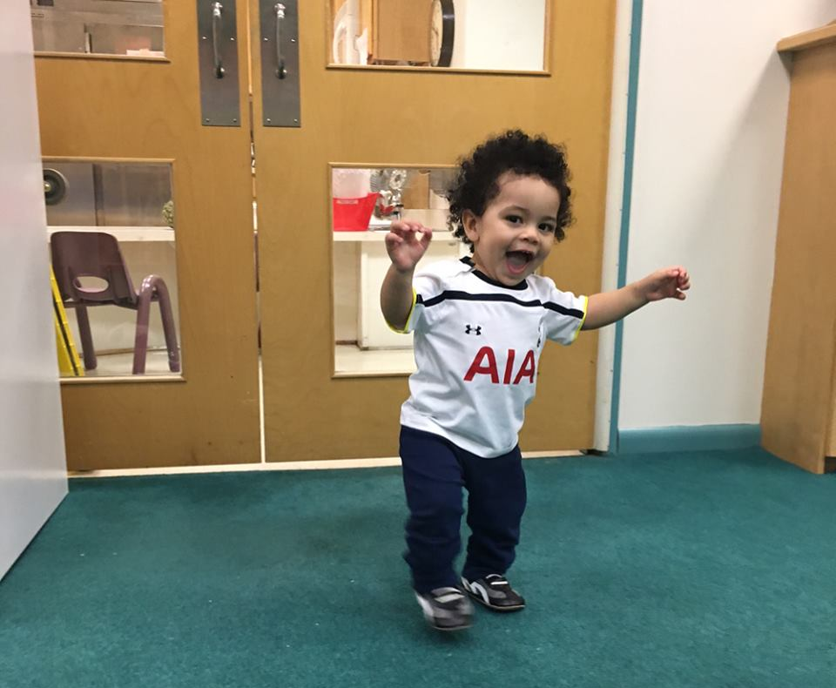
How does knowing social emotional milestones help you build supportive relationships and promote social emotional development of infants, toddlers and young children?
Notes:
Describe that reading children's cues is an important part of understanding their behavior and building relationships with young children.
Ask participants, “How does knowing social emotional milestones help you build supportive relationships and promote social emotional development of young children?”
Add any of the following points to supplement the participant discussion Knowing social emotional milestones is important:
• because some research has indicated that families and caregivers demonstrate less understanding of when children are capable of reaching social emotional milestones than cognitive or physical ones. This lack of understanding may lead to adults having unrealistic expectations for young children, and ultimately frustration.
• to determine if a child is on track or if there may be a delay—without knowing what is appropriate for various ages, you can't know if something is on track or if the child may have a delay
• for identifying strengths
• for intervening early to maximize the effectiveness of the interventions (the earlier the intervention is provided the more likely it is to be effective)
• for ensuring expectations are age appropriate e.g., you wouldnʼt expect a 2 year old to share or verbally tell you what is wrong
• for planning developmentally appropriate experiences and activities
• for preventing children from engaging in challenging behavior if they are frustrated by the environment, social situation, or unable to engage in tasks they would like to
• for better understanding a child's behavior
• for helping caregivers interact with children appropriately
• for aligning parent and caregiver expectations about behavior and development

Slide 51
The Developmental Continuum from Birth to 15 months:
Social and Emotional Indicators*
Age Range | Attachment Trust/Security | Self-Awareness/ Identity | Exploration Autonomy/Independence
Infant (Birth to 15 months) | Newborns recognize human language and prefer their own mother's voice Prefer human faces Early social interaction is a smile and mutual gazing Crawls away but checks back visually; calls, and gestures to ensure adult contact Stretches arms to be taken Prefers familiar adults Acts anxious around strangers Uses a blanket or stuffed toy for security and reassurance | Goes from accidentally sucking own hands to carefully watching them Tries to make things happen Hits or kicks things to make a pleasing sight or sound continue Talks to self when alone Prefers to be held by familiar people Imitates adult behaviors Knows own name Understands simple directions | Brings thumb or hand to mouth Tracks mother’s voice Observes own hands Babbles using all types of sounds Uses a few words mixed with babbling to form sentences Tries to keep a knee ride going by bouncing to get the adult started again Shows strong feelings (anger, anxiety, affection)
*This list is a sampling of developmental indicators and is not intended to include all behaviors associated with early development. For infant, there is considerable overlap among areas of growth. The term “mother” is used to represent the primary attachment figure.
Notes:
As we look at the next few slides, explain the following points to participants:
a. The first and second columns (Attachment, Trust/Security and Self-Awareness, Identity/Self-Esteem) focus on the elements of social emotional development that we have been discussing: forming close and secure relationships and experiencing, expressing and regulating emotions. Out of a strong, positive attachment relationship in which young children receive responsive care and are helped to manage and express their emotions, they develop trust in others and a sense of security. Through relationships that support their self-awareness, young children develop a sense of who they are and what they can accomplish and learn. If a child does not have opportunities to form nurturing, supportive relationships it is significantly more difficult for them to progress through the social-emotional milestones.
b. The third column ( Exploration, Autonomy/ Independence) focuses on another element of social emotional development, the ability to explore and learn. Through relationships that support safe exploration, infants and young child gain the sense of autonomy and independence that is so necessary to learning and success in school and in later life.

Slide 52
The Developmental Continuum from 12 months
to 2 ½ years: Social and Emotional Indicators (cont’d)
Age Range | Attachment Trust/Security | Self-Awareness/ Identity | Exploration Autonomy/Independence
Toddler (12 mos. to 2 1/2 years) | Relates to others by exploring things with them Pulls up, stands holding furniture, then walks alone Goes through a phase of clinging to primary caregiver Experiences periods of intense feelings when separating or reuniting with a parent Sees others as a barrier to immediate gratification | Knows can make things happen but is not sure of responsibility for actions Becomes bossy Uses the words me, you, and I Says "No" to adults Explores everything Is sensitive to others' judging behavior | Keeps looking for a toy that is hidden from view Understands many more words than can say Has wide mood swings (for example, from stubborn to cooperative) Wants to do things by self
Adapted with permission from J. Ronald Lally, Abbey Griffin, et al., Caring for Infants and Toddlers in Groups: Developmentally Appropriate Practice (Washington, DC: ZERO TO THREE/The National Center, 1995), pp. 78-79.
Notes:
Feeding story

Slide 53
The Developmental Continuum from Age 2 ½ - 3 ½ :
Social and Emotional Indicators (cont’d)
Age Range | Attachment Trust/Security | Self-Awareness/ Identity | Exploration Autonomy/Independence
Preschool (2½ to 3½ years) | Is capable of dramatic play Has better control over all aspects of self Needs to practice Needs adult coaching to get along well with others Shows feelings with words and in symbolic play Is more aware that others have feelings Can plan ahead | Is capable of self-evaluation (for example, good, bad, pretty, ugly) Tries to control self (for example, emotions and toileting) Is learning to take turns in conversations Knows a lot about communicating in the style of own culture Can play well with others if the setting is right | Uses names of self and others Can tell others about what happened that day Has much larger vocabulary to express ideas Shows concern for others Classifies, labels, and sorts objects and experiences into groups
Adapted with permission from J. Ronald Lally, Abbey Griffin, et al., Caring for Infants and Toddlers in Groups: Developmentally Appropriate Practice (Washington, DC: ZERO TO THREE/The National Center, 1995), pp. 78-79.

Slide 54
Development Presents Opportunities and Challenges
As infants develop, new challenges may emerge
Challenges may occur because new development has not yet occurred (e.g., child may not have developed the ability to express her wants and needs verbally)
Development creates the need for relationship shifts and modifications in caregiving
Notes:
Through out development new challenges emerge.
• As new development occurs other development may temporarily shift or become disrupted (e.g.,as a child begins to learn to walk or talk, his sleep may become disrupted, and he may suddenly wake more often or have difficulty falling asleep).
• As a child develops, the caregiverʼs relationship with the child will need to shift (e.g., as a toddler is able to crawl or walk, the caregiver will need to allow him increased independence to explore).
• Sometimes our expectations of children lead us to view their behavior as challenging when infact it may be typical developmental behavior (e.g., while tantrums can be challenging, they are part of typical development).
• Challenging behavior may also be a consequence of a skill that has not developed yet(e.g., a child may bite because he lacks the ability to use words to describe what she needs).

Slide 55
Importance of Social Emotional Screening
Use validated screening instruments that can identify strengths as well as possible social-emotional areas of need in infants and toddlers
Early identification of young children with social emotional needs is key
A screening tool is only as valuable as the conversation it inspires between the person administering the tool and the family
Notes:
Share with participants that social emotional development in young children does not always proceed as expected. In some instances, infants or toddlers may not give clear or consistent cues about their needs, making it difficult for families and caregivers to know how to respond. Social emotional screening can help families and caregivers further identify a childʼs social emotional strengths, as well as better understand possible are as of need. Screening can help indicate whether a young child should receive a more in-depth assessment or evaluation. Screening involves more than the use of a validated tool or instrument. The screening process includes gathering information from families, caregivers and others who know the young child best.

Slide 56
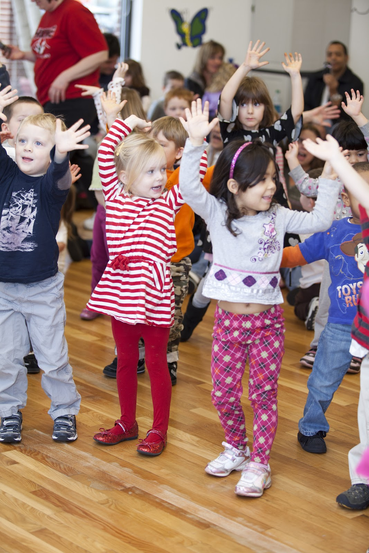
Activity
Can you follow
a 3 step direction?
Notes:
If you have any physical limitations, please remain seated and follow along to the best of your ability

Slide 57
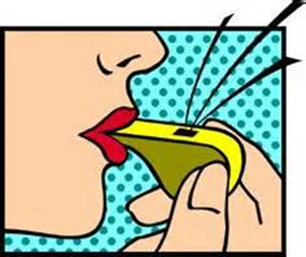


Can You Follow a 3 Step Direction?
Blowing of whistle = rolling of arms
Knock knock of wood = Boogie down
Dinging of a bell = Surprise

Slide 58

Understanding Behavior:
Making Sense of What You See and Hear
4. Temperament
Notes:
In addition to understanding individual childrenʼs cues and typical social emotional development, learning about a childʼs specific traits or temperament will also help caregivers and families better understand and respond to a young child.

Slide 59
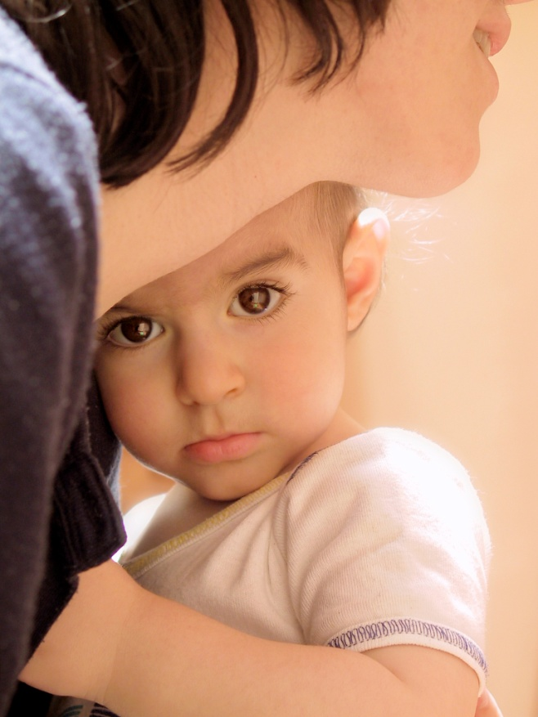
Temperament
Appears to be biologically based
Fairly constant over time
Affects a child’s reactions to other people and the environment
istockphoto.com/Grafissimo
(Wittmer & Petersen, 2006 based on Thomas, Chess, Birch, Hertzig & Korn, 1963)
Notes:
Each child is born with his/her own temperament or individual way of approaching the world. A child's behavior and approach to the world is shaped by his/her experiences and interactions with the adults in his/her life. Understanding a child's temperament helps us provide more responsive and sensitive care.
Some aspects of temperament are noticeable from birth and continue throughout life. Right from the start, we each have a unique genetic makeup which includes our nervous system and the way we take in sensory stimulation. For example, some people may like bright lights and loud music; others prefer the lights low and the music quiet. Some people eat and sleep in pretty regular patterns; others have no pattern at all. The concept of temperament helps us understand that children engage with the world according to their inborn characteristics.
A large part of a caregiverʼs job is to adapt his or her own temperament to meet the needs of the young child. For example, a caregiver who likes bright lights and loud music may need to provide less stimulation by talking more softly, reducing the lights and other noise. The
degree to which this is managed is referred to as “goodness of fit. ”The sensitive adult adapts his or her behavior in such away as to not require the infant to make the adaptation, knowing it would be stressful for the infant. The adult seeks to match her behavior to meet the infant's needs.
• It is also important to understand the impact of in born, biological differences on the behavior of individual children. Learning about temperament can help caregivers understand more about how these in born traits play a major role in a child's pattern of behavior and may eventually have a major influence on how a child feels about him or herself. For example, if a toddler is easily distracted, and has irregular patterns of sleeping and eating yet no accommodations are made to meet his needs for eating and sleeping at different times or to reduce the stimulation to help him become calm, he may begin to feel that others don't understand him or caregivers don't know how to help him.
• Understanding an infant's or toddler's temperament can help us begin to anticipate what situations may be easy or more difficult for the child.
• Sometimes forming relationships with infants and toddlers can be easier or more difficult depending on a variety off actors including the child's and caregiver's personality or temperament.

Slide 60
Temperament Traits
Activity level – always active or generally still
Biological rhythms – predictability of hunger, sleep, elimination
Approach/withdrawal – response to new situations
Mood – tendency to react with positive or negative mood, serious, fussy
Intensity of reaction – energy or strength of emotional reaction
Sensitivity – comfort with levels of sensory information; sound, brightness of light, feel of clothing, new tastes
Adaptability – ease of managing transitions or changes
Distractibility – how easily a child’s attention is pulled from an activity
Persistence – how long child continues with an activity he/she finds difficult
Adapted with permission from Wittmer and Petersen, 2006
Notes:
Explain that there are nine traits that are considered to be key components of a child's temperament (Wittmer & Petersen, 2006 based on Thomas, Chess, Birch, Hertzig, & Korn,1963).
Read each trait aloud.
Provide participants Handout 1.11 and ask them to pair off and describe their own temperaments using the nine traits listed.

Slide 61
Temperament Types
Flexible | Fearful | Feisty
Regular rhythms | Adapts slowly | Active
Positive mood | Withdraws | Intense
Adaptability |  | Distractible
Low intensity |  | Sensitive
Low sensitivity |  | Irregular
 |  | Moody
Notes:
Point out that there are three temperament types into which many children fall. Each of these three common temperament types is characterized by a trait that may dominate the childʼs behavior. Briefly describe the temperament types:
• The easy or flexible child is generally easy to care for. She adapts quickly to new situations, is biologically regulated, is optimistic in her approach to new people, and generally has a positive mood. She tends to learn to use the toilet without a lot of difficulty, sleeps through the night, and has regular eating and sleeping patterns. She enjoys new people and places and typically gives mild signals of distress. Even when very unhappy, this child may cry little
The feisty child is often the opposite. This child may be hard to get to sleep and sleeping and eating patterns are irregular. Toilet training may be more difficult because of irregular bowel patterns. This child may fuss or cry at loud noises, and is often wary of new people and things. He is slow to warm up and may escalate to temper tantrums quickly if frustrated. He may have frequent unhappy moods. This child may be very noisy when even slightly unhappy.
• The third group of children often has difficulty adapting to new people and places. They are often called fearful, shy, or slow-to-warm. Their mood may not be easy to gauge because it takes longer for them to engage with a group or a new activity. Their biological rhythms may or may not be regular.

Slide 62
Temperament Video
https://www.zerotothree.org/resources/211-temperament

Slide 63
Think About:
  What is the child like?
  How calm or active is she?
  How does she respond to changes in routines?
  How does she deal with a lot of stimulation?
  How does she let you know she likes something, dislikes something, etc.?
Notes:
To help identify and better understand a child's temperament, you might think about:
• What is the child like?
• How calm or active is she?
• How does she respond to changes in routines?
• How does she deal with a lot of stimulation?
• How does she let you know she likes something, dislikes something, etc.?

Slide 64
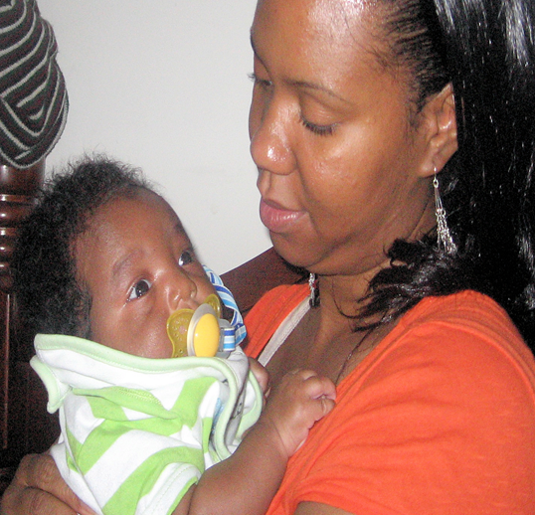
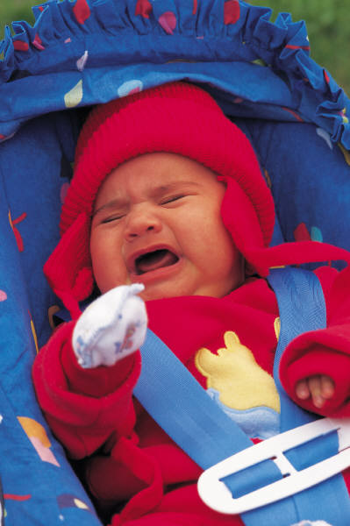

Temperament Types
Flexible, Fearful, and Feisty
Notes:
Ask participants to look at the photos of three children whose captured expressions are indicative of these different types of temperaments.
• Invite them to think about a child they find challenging. Ask them to review the nine temperament traits and identify those that seem to characterize that child.
Ask participants:
• Do you think that any of these temperament traits are part of what is challenging to you? Is that because the child is different from you–or perhaps because that child is similar or like you?” Acknowledge that some temperaments are easier for us to handle than others, but it is still very important for children to feel accepted for who they are!

Slide 65
Why Is Understanding Temperament Important?
Helps caregivers to be more responsive and effective
Children get the message they are wonderful and accepted exactly the way they are
Helps to support relationship building
Notes:
65
Highlight the following points with participants:
When we understand a child's temperament, we can begin to anticipate what situations may be easy or more difficult for him.
By understanding a child's temperament, we can nurture and support strengths as well as help a child learn ways to cope with challenges.
We can adapt how we care for a young child based on his/her temperament style.
Understanding temperament is an important part of and way to build and enhance relationships between adults and young children

Slide 66
Team Temperament Activity
Sit in a small group with your team
Using one copy of the temperament scale handout, note where you each fall with a different color marker on your team’s temperament scale
Discuss what you learn—surprises, insights?
Notes:
66
Handout 1.12
Highlight the following points with participants:
When we understand a child's temperament, we can begin to anticipate what situations may be easy or more difficult for him.
By understanding a child's temperament, we can nurture and support strengths as well as help a child learn ways to cope with challenges.
We can adapt how we care for a young child based on his/her temperament style.
Understanding temperament is an important part of and way to build and enhance relationships between adults and young children

Slide 67
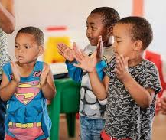
Understanding Behavior:
Making Sense of What You See and Hear
5. Understanding Children’s Cues
Notes:
We just finished discussing how observation is one of the most powerful skills and strategies for learning about young children. When we observe infants and toddlers we see they use many gestures, sounds and facial expressions to communicate with those around them.

Slide 68
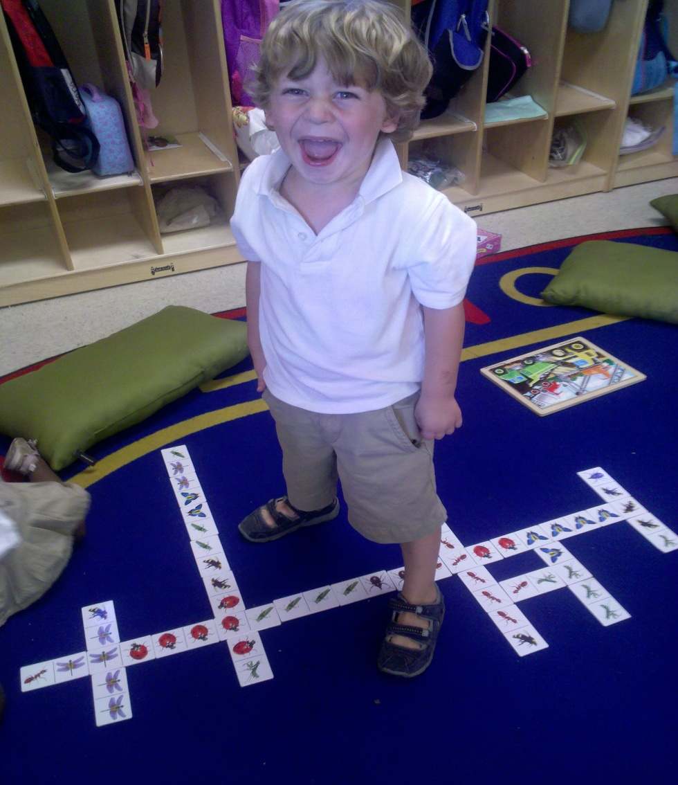
Cues of Young Children
Engagement cues – “I want more.”
Disengagement cues – “I need a break.”
NEED PHOTOS
Shared by Amy Hunter
Notes:
Explain to participants that young children let us know of their needs and wants through cues, or behavior. When we observe their cues, we can better understand how a young child feels with indifferent relationships. Since families know their children best, caregivers can ask them about their children's cues and behaviors and what they notice at home. Cues convey emotions a young child is experiencing, associated with a specific need. For example, an alert facial expression and relaxed body tell us that an infant is ready to interact. Sometimes subtle cues, such as looking away or turning his head, tell us that a baby needs a break from the interaction. Engagement cues are a type of behavior or communication that signals the young child's readiness to interact with caregivers. Disengagement cues are behaviors that signal the young child's need for a reduction or change in level of stimuli.

Slide 69
What Cues Do Children Give You?
To show they are engaged?
  Infants
  Toddlers
To show they are disengaged?
  Infants
  Toddlers
Notes:
Ask participants to share examples of cues from young children that tell us when they are engaged or disengaged.
Participants may share examples such as those listed on the next slide.
Elicit examples such as: when an infant is disinterested or needs a break he may turn his head; when an infant is engaged he may smile and/or look at an object; a child who is disengaged may yawn or arch his back; or an engaged child may widen his eyes or arch his eyebrows.

Slide 70
Young Children Communicate in Many Ways
Gaze aversion (looking away)
Yawning
Pushing out of the lips
Smiling
Eyebrow raising
Eyes widen and sparkling
Dull look/blank facial expression
Giggling
Squealing
Pulling away
Joining of hands
Arching back, stiffening
Reaching for caregiver
Lowering of the head
Lengthy mutual gaze
Hand to mouth
Hiccups
Stiffening muscles
Notes:
Review the list with participants and let them know these are examples of some, but not all, ways in which young children communicate

Slide 71

Strategies for Helping Young Children Self-Regulate
Contain their limbs with swaddling or by cuddling; gently hold babies close to your chest and heartbeat
Offer and encourage infants, toddlers, and young children to use comfort items such as a pacifier, blanket, or favorite stuffed animal or offer your finger or thumb to hold or squeeze
Hold, rock, cuddle, sing and read to infants and toddlers
Respond promptly and consistently to young children’s needs
Notes:
Review the bullet points noted on the slide with participants
*Please follow the American Pediatric Association’s or agency guidelines on swaddling

Slide 72

Understanding Behavior:
Making Sense of What You See and Hear
6. Challenging Behavior and
Social-Emotional Development
Notes:
Share with participants that together you have discussed social emotional development and why it is important, defined social emotional development of young children, and reviewed social emotional milestones. We also highlighted the need to continuously observe young children and families. Through observation, we learned that we can better understand a young child's temperament and supportive ways to respond. Each of these concepts will contribute to a more complete understanding a young child's strengths and possible areas of need.
Share the following points with participants:
The stages of young children's social emotional development, their developmental readiness to learn new things, their temperament, their emotional needs and environmental factors all help guide us on how best to understand and respond to their behaviors.
Once we are able to better understand and identify a young childʼs social emotional development, it is then often easier to understand why a young child behaves and responds in certain ways, as well as determine the best ways to relate to, support and provide developmentally appropriate guidance.

Slide 73
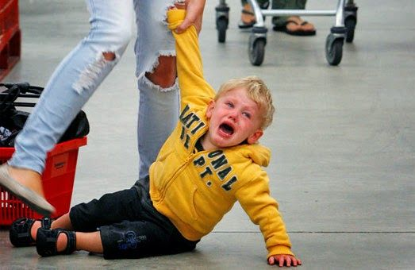
The Basics of Behavior
Behavior has a message
Children may display “challenging behavior” because they do not have other skills to meet their intended need
We can focus on understanding the behavior, meeting the child’s need, and teaching children what to do in place of the challenging behavior
Notes:
Review slide
Understanding the message behind or meaning of behaviors gives us clues as to how to intervene or respond to the behaviors in the most effective ways.
Rising up the Pyramid to targeted responses to challenging behaviors further Pyramid trainings provides information about how to appropriately and effectively respond to an infant or toddler's behavior that maybe intense, frequent, and lasting in duration (behavior that has not responded to typical high quality early childhood practices). Pyramid trainings offer many strategies to help prevent challenging behavior from occurring and/or becoming worse. As the professionals who worked with Andrew and his family thought about and tried to understand the meaning of Andrew's behavior, they engaged in a process of reflection. The strategy of reflecting on behaviors and our own attitudes about behavior is described and taught

Slide 74
Some Basic Assumptions
Challenging behavior usually has a message: I am bored, I am sad, you hurt my feelings, I need some attention.
Children often use challenging behavior when they don’t have the social or communication skills they need to engage in more appropriate interactions.
Behavior that persists over time is usually working for the child.
We need to focus on teaching children what to do in place of the challenging behavior.
Notes:
Understanding the message behind or meaning of behaviors gives us clues as to how to intervene or respond to the behaviors in the most effective ways:
Our focus on the bottom of the Pyramid offers many strategies to help prevent challenging behavior from occurring and/or becoming worse.
How to appropriately and effectively respond to a young child’s behavior that may be intense, frequent, and lasting induration(behavior that has not responded to typical high quality early childhood practices).

Slide 75
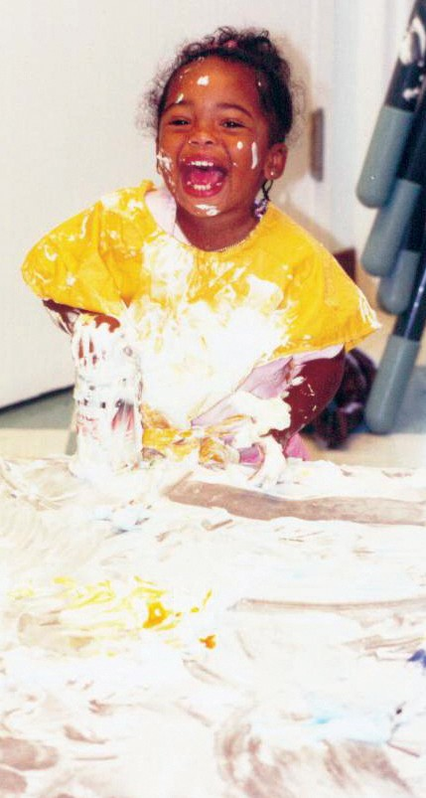
The Relationship Between Social Emotional Development and Behavior
Behavior has meaning and it is communicating a message…
  A smile may mean …
  Two arms stretched up
  may mean…
  Pointing at a bottle
  may mean…
Notes:
Share with participants that to understand both social emotional development and behavior (including challenging behavior) we must understand that all behavior has meaning. For example, when a baby “first smiles” it might mean “I'm happy” or “I like what I see. ”When a baby “stretches two arms up ”he might be saying, “Pick me up. ” As a baby“ points to a bottle” she may be saying, “I want my bottle.”

Slide 76
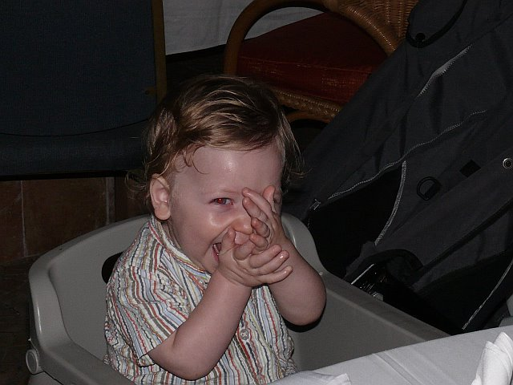
The Relationship Between Social Emotional Development and Behavior
A 3-month-old screams and cries for long
periods of time because…
A 17-month-old hits another child because …
A 2-year-old says “no” frequently because…
Provided by Amy Hunter
Notes:
Large group activity
Trainer’s Note: This can be done as a large group or in small groups at tables.
While displaying Slide 79, ask participants to identify what these infants or toddlers maybe trying to communicate with their behavior. Possible responses may include:
•“ A 3-month-old screams and cries for long periods…” —perhaps she has colic, maybe he wants the caregiver's attention, maybe he doesn't know the caregiver or feel secure, perhaps she is uncomfortable or in pain, perhaps he is hungry, cold or wet, maybe it is a new environment and he is scared.
• “A 17-month-old hits another child”—he may want a toy the other child has; he maybe curious about what the child will do in response; he may want to play; perhaps the other child is in his space; he may not know what else to do to get his needs met and/or his point across.
• “A 2-year-old says ʻnoʼ frequently because…”— perhaps he has heard “no” frequently and is experimenting with language; he maybe trying to have some power, control and independence; he may be trying to understand what “no” means; he may not want to do something.

Slide 77
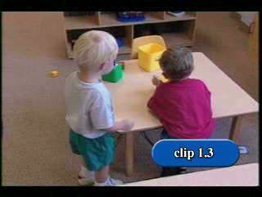
Video 1.3 What Is The Biting
Trying to Tell Us?
Notes:
Video Clip 1.3. What is The Biting Trying to Tell Us?
Tell participants you are going to show a video. Ask them to observe closely the sequence of events. After watching the video, ask participants to describe what they observed. A detailed description is included below.
Video Description: The boy stands at a child-sized table playing with a set of nesting blocks in a toddler classroom. Andrew approaches this boy, wraps his arms around the boy’s shoulders, and places his open mouth onto the boy’s cheek and then his shoulder. The boy backs away from the table as he places the blocks onto the table. Andrew reaches for these blocks. The other boy goes to the other end of the table and picks up another block. He raises it into the air and says, “Mine.” Andrew leaves his blocks and heads toward the boy and the block. The other boy runs away from Andrew. Andrew chases him around the table. A teacher calls, “Andrew.” Andrew stops running and looks toward her voice. He points to the boy and cries, “I want it.”The other boy runs completely around the table and heads near Andrew. Andrew approaches with his hand out.The boy runs in the opposite direction.The teacher says, “Andrew.” Andrew stops chasing and pouts.The other boy says, “Mine!” and runs in the opposite direction. He then giggles and says, “I got it.”
Next scene, Andrew is standing next to a shelf playing with a bead tracking toy.The other boy steps toward Andrew and the toy. Andrew says, “Mine,” and pulls the toy away. Andrew opens his mouth and leans toward the boy.The boy takes a step back. He pauses briefly, then reaches for the toy. Andrew opens his mouth.The boy then steps closer. He holds onto one of the wire tracks and pulls it toward him. He bites the track. Andrew leans his open mouth toward the boy’s shoulder. A teacher approaches the two boys. She gently guides the other boy away from Andrew and the toy. She tells Andrew, “Remember, we share at school.” She tells the other boy, “Let’s go get some things to do.”
Ask participants what Andrew might be trying to communicate with his biting. Possible responses may include:
• He may want the toy.
• He may want to play with the other boy.
• He may not know how to communicate in another way.
• He may have learned that biting is an effective way to get what he wants.

Slide 78
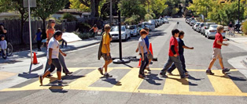
Pyramid Model &
Early Childhood System of Care Crosswalk
The Pyramid model asks primary care teams to consider:
How the physical environment supports the development of positive relationships
How team and family interactions support the development of positive relationships
What we do to promote young children’s social-emotional wellness
Where the strengths and gaps are in our prevention and intervention work

Slide 79

Behavioral Health Integration
Children need supportive environments in which to grow and learn—their medical homes are important touch points for this work
We can address health disparities by creating a shared vision among community members
Mental and behavioral health is increasingly seen as a key component of overall health
The PL and SOC grants are part of this movement!
Notes:
Project Launch brochure need web site

Slide 80
Connecting the Dots: the Pyramid in Primary Care
From framework….
Promotion strategies
Prevention strategies
Intervention strategies
….to action
Social-emotional wellness
materials in exam rooms
Universal screening efforts
Family events
Referrals for individualized child assessments /consultations
for SE difficulties
Referrals for community resources
Individualized MH intervention
Referrals to specialized
IECMH services

Slide 81
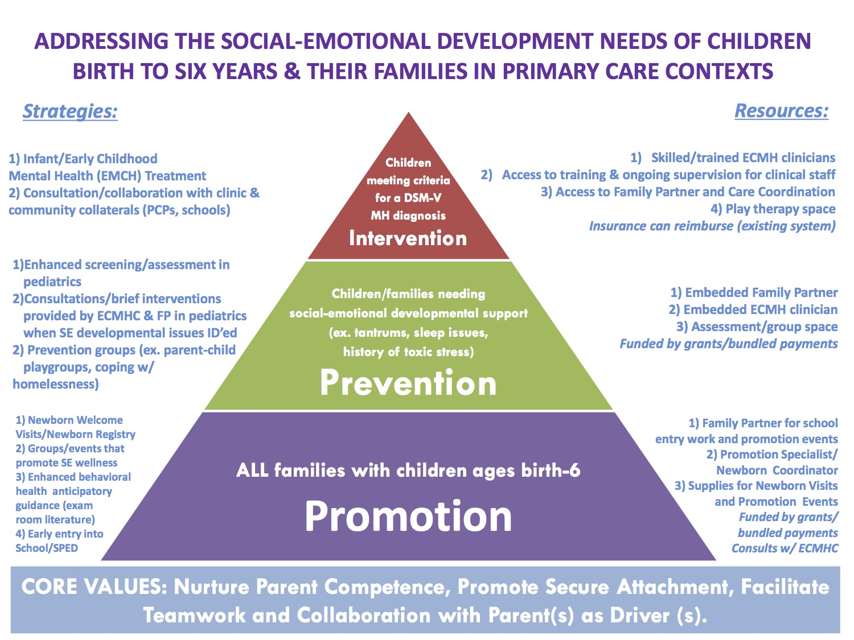
The Framework in Action
Assists us in….
Organizing our strategies
Identifying strategies at each level
Grounding in core IECMH values
Describing program model and supporting sustainability efforts

Slide 82

The Pyramid is the scaffolding….but what are we building?
Activity:
Take some sticky notes
Thinking about your site, write down two strategies you are either already doing or would like to do at each level of the Pyramid
Put your stickies on the large pyramid

Slide 83
Major Messages
Each level of the Pyramid represents ways we can contribute to the social emotional development of infants, toddlers, and preschoolers.
Three major elements of social emotional wellness are
  forming close and secure relationships
  experiencing, expressing and regulating emotion
  exploring the environment and learning
The Framework can guide the implementation and development of our IECMH programs in primary care.
Notes:
The Pyramid Model describes an approach to promoting social emotional competence in early childhood

Slide 84


Questions
What questions do you have about the material we discussed?
What insights if any do have about your own practices, the children, and/or their families?
What strategies did you see or hear that might be useful in your role and work?

Slide 85

Evaluations

Slide 86
Notes:
Homework
Please visit one site tonight
What did you learn?

Slide 87
Foundations of the Pyramid Model in Primary Care
Notes:
Common focus: supporting children and families for better outcomes.

Slide 88
Schedule & Agenda
DAY 2
Connecting the dots: How the Pyramid Model supports promotion and prevention early childhood system of care strategies (30 min.)
Promoting Social Emotional Development in Pediatric Care: Multidisciplinary consultation (30 min.)
Inventory of Practice: What social emotional practices are in place? (30 min.)
Pyramid Parent Modules: PIWI & POS: Building Competence, Confidence, and Mutual Enjoyment (120 min.)
Family Engagement and Routine Based Strategies: Family Routine Guides (60 min.)
Nurturing Environments: Make & Take visuals for home, waiting room and exam room (30 min.)

Slide 89
Objectives Day 2
Participants will understand the Pyramid Model Framework and how it can be applied in primary care during office visits, home visits, consultations, and groups.
Participants will be able to identify strategies for building nurturing and responsive relationships with young children and supporting the parent-child relationship.
Participants will identify how understanding the needs of young children relates to building positive relationships and the supportive environments.
Participants will identify prevention and promotion strategies for children and their families that can be used in pediatric primary care setting during office visits, home visits, consultation, and groups

Slide 90
Video
https://www.youtube.com/watch?time_continue=5&v=I8wCsdSRcVM

Slide 91
Context: Project LAUNCH’s
Prevention and Promotion Strategies
Enhance home visiting through focus on social and emotional well-being
Screening and assessment in a range of child-serving settings
Integration of behavioral health into primary care
Mental health consultation in early care and education
Family strengthening and parent skills training
Notes:
http://www.healthysafechildren.org/project-launch-framework
5 strategies the NATIONAL FOLKS

Slide 92
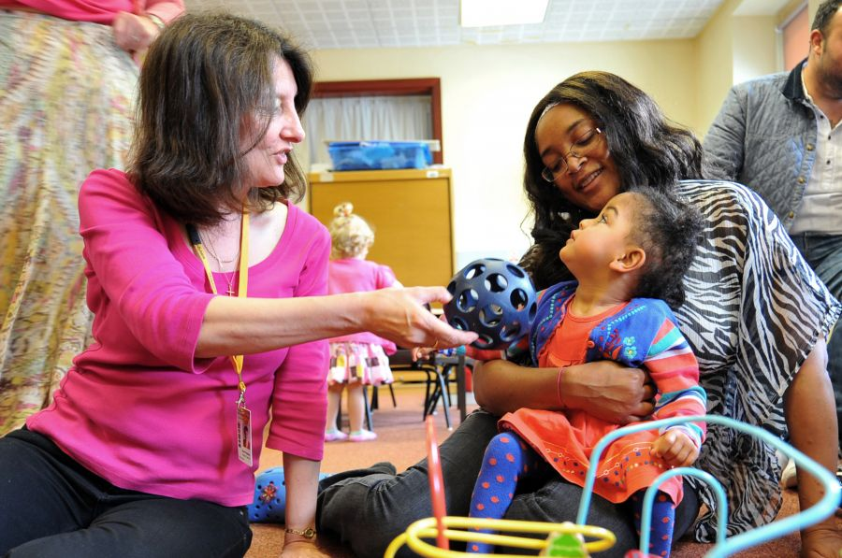
Laying the Foundation:
In your work, how do you already support the parent-child relationship?
Notes:
Inventory of Practices
Readiness/buy-in
Planning – who are your champions

Slide 93
Integration of Behavioral Health in Primary Care
Intervention
Prevention
Promotion
Therapy using evidence-based interventions (incl. CSEFEL)
Access to care coordination/family supports
Groups using CSEFEL materials (PIWI, Pos Solutions)
Individualized consultations for children and caregivers to promote soc-emot skills (Tucker the Turtle, for example)
Exam room materials that promote social-emotional dev
Universal screening for soc-emot issues in IECMH (EPDS, ASQ, etc.)

Slide 94
Examples: Exam Room Materials

Slide 95

Tucker Turtle Takes Time to Tuck and Think
Examples: Caregiver Consultation Materials
A scripted story to assist with teaching the “Turtle Technique”
By Rochelle Lentini, University of South Florida
Updated 2007
Created using pictures from Microsoft Clipart® and Webster-Stratton, C. (1991). The teachers and children videotape series: Dina dinosaur school. Seattle, WA: The Incredible Years.

Slide 96
Teacher Tips on the Turtle Technique
Model remaining calm
Teach the child the steps of how to control feelings and calm down (“think like a turtle”)
  Step 1: Recognize your feeling(s)
  Step 2: Think “stop”
  Step 3: Tuck inside your “shell” and take 3 deep breaths
  Step 4: Come out when calm and think of a “solution”
Practice steps frequently (see cue cards on next 4 pages)
Prepare for and help the child handle possible disappointment or change and “to think of a solution” (see list on last page)
Recognize and comment when the child stays calm
Involve families: teach the “Turtle Technique”
Webster-Stratton, C. (1991). The teachers and children videotape series: Dina dinosaur school. Seattle, WA: The Incredible Years.

Slide 97
Family Strengthening & Parent Skills Training in Primary Care
Intervention
Prevention
Promotion
Use of CSEFEL modules in parent meetings and consultations (PIWI/POS, etc.)
Groups where caregivers learn strategies, such as “Filling the Bank”
Access to tools through PCPs, other forums
Caregiver involvement in organizational planning/advisory groups
Activity nights/game nights/family programming to support positive interactions
Spaces/materials that affirm families’ cultural identities

Slide 98

Let’s explore…
http://www.ecmhmatters.org/ForProfessionals/Documents/Toolkit/BPHC_PowerPoint_Project_Section_2_FINAL.pdf
Notes:
Pages 8 - 16

Slide 99
How does IECMH Consultation look in Primary Care?
Intervention
Prevention
Promotion
Strengths-based child conferences
School-based child-specific consultations
In-clinic “curbside” consults for providers about IECMH
Individualized training on aspects of IECMH
General trainings on IECMH
Observations of clinic processes related to IECMH

Slide 100

IECMH Consultation
Infant and Early Childhood Mental Health Consultation (IECMHC) is a multi-level preventive intervention that teams mental health professionals with people who work with young children and their families to improve children’s social-emotional, relational, and behavioral health and development. IECMHC is primarily indirect work with caregivers, NOT direct service with children.
Notes:
What it is:
Promotes social emotional development • Addresses children’s challenging behavior • Primarily indirect services • Impacts child, family, staff, and outcomes
What it isn’t:
Formal diagnostic evaluations • Therapeutic play groups • Individual therapy • Family therapy • Staff therapy • Family support groups
Types of consultation:
Child and family centered • Programmatic

Slide 101
How does IECMH Consultation look in Primary Care?
Intervention
Prevention
Promotion
Strengths-based child conferences
School-based child-specific consultations
In-clinic “curbside” consults for providers about IECMH
Individualized training on aspects of IECMH
General trainings on IECMH
Observations of clinic processes related to IECMH

Slide 102
From Framework to Practice
How does your team provide consultation related to themes and topics in IECMH to your sites?
What steps might you take to formalize or enhance this?
IECMH Consultant Self-Assessment tool :
https://www.ecmhc.org/documents/CECMHC_SelfAssessment.pdf

Slide 103

Inventory of Practices
What is an inventory of practice?
A tool that helps team assess their strengths and needs related to the strategies they use to promote social-emotional wellness among young children and families
Includes an action plan section
Notes:
Inventory of Practices IOP
One of the fundamental strategies of Pyramid implementation is IOP. IOP also is supported and a key element of Implementation Science.
It may be helpful to take an ABC approach when thinking of practices.
A – what is already in place
B - what is beginning to emerge
C – what

Slide 104

Examining Attitudes about Challenging Behaviors
What behaviors push your button?
  How do these behaviors make you feel?
  What is your response when these behaviors occur?
  How does this impact your relationship with a child and his/her family?
Notes:
Small group activity
Acknowledge how difficult it is to deal with children with challenging behavior. Explain how important it is for teachers and other caregivers to have support when they are working with children with challenging behavior. It is difficult to see beyond the challenging behavior, and it helps to ha

Slide 105
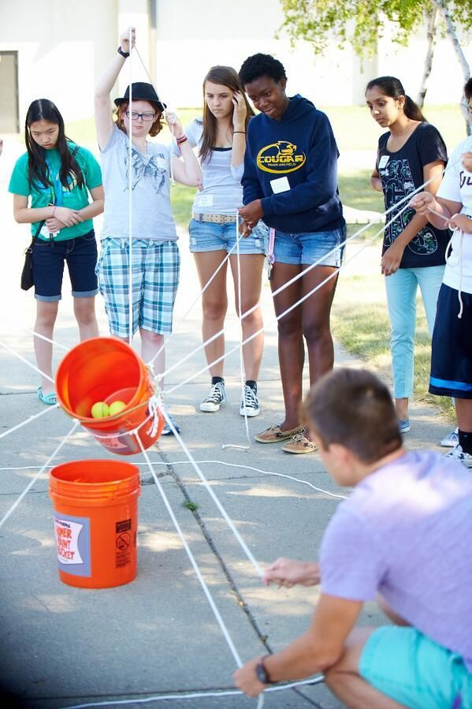
Team Time: Inventory of Practice
Activity:
Sit with your team members
Using the handout provided, complete ONLY THE SECTIONS ON 1) BUILDING POSITIVE RELATIONSHIPS AND 2) INDIVIDUAL INTENSIVE INTERVENTIONS
Select ONE of these areas to complete a team action plan
You will have 30 minutes for this discussion
Team will share with the large group
Notes:
Handout IOP

Slide 106
Inventory of Practice: Group Discussion
Please share:
General reflections about the process of doing the Inventory of Practice
What areas of strength did your team identify?
What areas of growth did your team identify?
What strategies did your team imagine to address these needs?

Slide 107

Family Engagement
Improve outcomes for young children by helping their parents and other family members to provide healthy, safe, and secure family environments in which to learn and grow.
Notes:
Share with participants that we cannot truly know and understand each young child in our care unless we know and understand each child's family.
How do we do this in primary care?

Slide 108
Building Relationships With Families and Supporting the Parent-Child Relationship
A child’s first and primary teacher is the family
Supporting and enhancing the parent- child relationship is one of the most important roles caregivers have
Caring for infants and toddlers is caring for the family
Notes:
Ask participants, “How does building a healthy relationship with parents help you have a more secure relationship with their children?” Parent-caregiver communication about the child is a means of linking the home and other community environments and by seeking and sharing information, this should contribute to greater knowledge about the child and therefore influence sensitive caretaking practices. One study found that when mother and caregiver reported more frequent communication with one another about

Slide 109
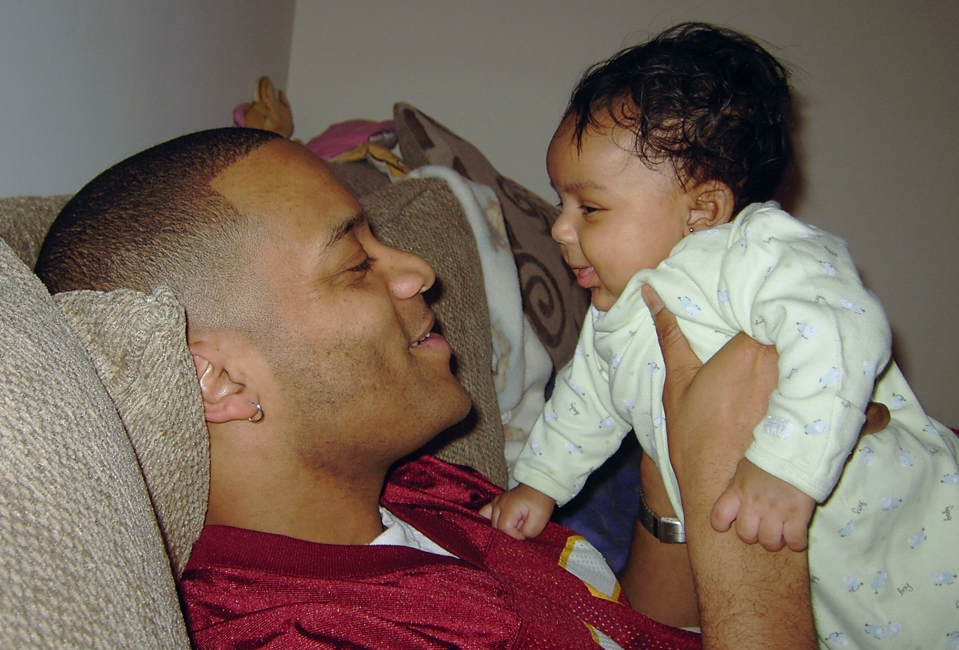
Learning From Families
Notes:
It is within their families that infants and toddlers learn about their culture and experience relationships that influence their sense of who they are and who they will become.
Talking with families about their cultural practices, traditions and beliefs provides the message they are valued.
Talking with families is not enough – itʼs important for caregivers to reflect on their own cultural beliefs and practices, as well as be open to and accepting of different ways of caring and supporting infants, toddlers and families.

Slide 110
Strategies to Build Relationship With Families
Seek families’ knowledge of their child’s strengths, needs and interests
Ask families questions about their child
Ask families to help
Get to know family members as individuals
Share something personal
Share observations about their child
Notes:
Before discussing the next 2 slides, ask participants to share experiences where they successfully formed strong and close relationships with families.
Possible questions to ask participants are: • What impact did forming a close relationship with the family have on your relationship with the child? • What impact did this have on the parent-child relationship?
Then, show the next 2 slides and review the strategies.
Note that the participants who shared their experiences used many of the strategies listed below: • Seek parents' knowledge of their child's strengths, needs and interests • Ask parents questions about their child • Ask parents to help brainstorm challenges • Get to know the parent as a person • Share something personal about yourself (e.g., from your childhood or from your own children - “I remember my mom would tell me I never wanted to fall asleep just like Max,” or “My son, James, used to be afraid of the toilet flushing, too.”) • Share observations about their child (“I noticed today that Sara is really trying to pull up. Have you noticed her doing this at home?”)

Slide 111
Strategies to Build Relationships With Families
Develop policy around communicating with families and offer multiple ways to share information
Invite conversation, listen and follow up
Have regularly scheduled times for face-to- face meetings
Respect families’ views and child rearing beliefs
Seek family feedback of your care
Notes:
Invite conversation, listen, and follow up • Have regularly scheduled times for face to face meetings • Respect parent views and child rearing styles • Encourage parent suggestions and ideas • Seek parent evaluations about the child care program and staff • Communicate daily (offer multiple ways to communicate) • Talk about and share information about the child's daily activities and routines (e.g., eating, diapering/toileting, napping) • Create rituals for drop off and pick up Summarize with an emphasis on how critical forming trusting relationships with families is. Note that when families and caregivers form a trusting relationship, infants and toddlers feel more secure in their care, the care can be more attuned to the needs of the child, and the quality of the care in all settings can be higher and more consistent.

Slide 112
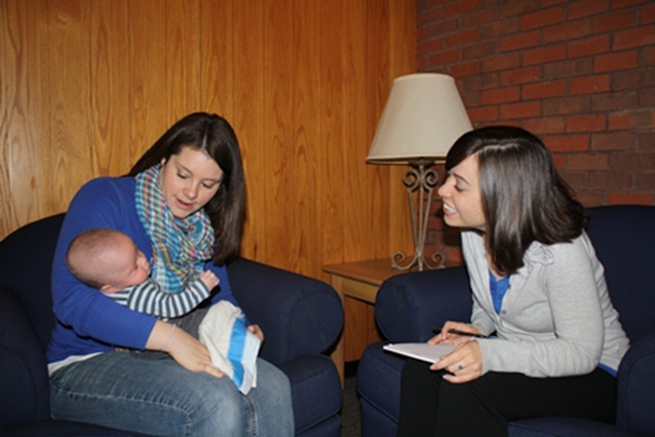
Forming and Sustaining Relationships with Young Children and Families
Notes:
Share with participants that an understanding of how the following variables all affect young children and their families: socioeconomic conditions; family structures, relationships, stresses, and supports (including the impact of having a child with special needs); home language; cultural values; ethnicity; and community resources, cohesiveness, and organizations. Knowledge of these and other factors helps create a deeper understanding of young childrenʼs lives. This knowledge is critical to caregiverʼs ability to help children learn and develop well.

Slide 113
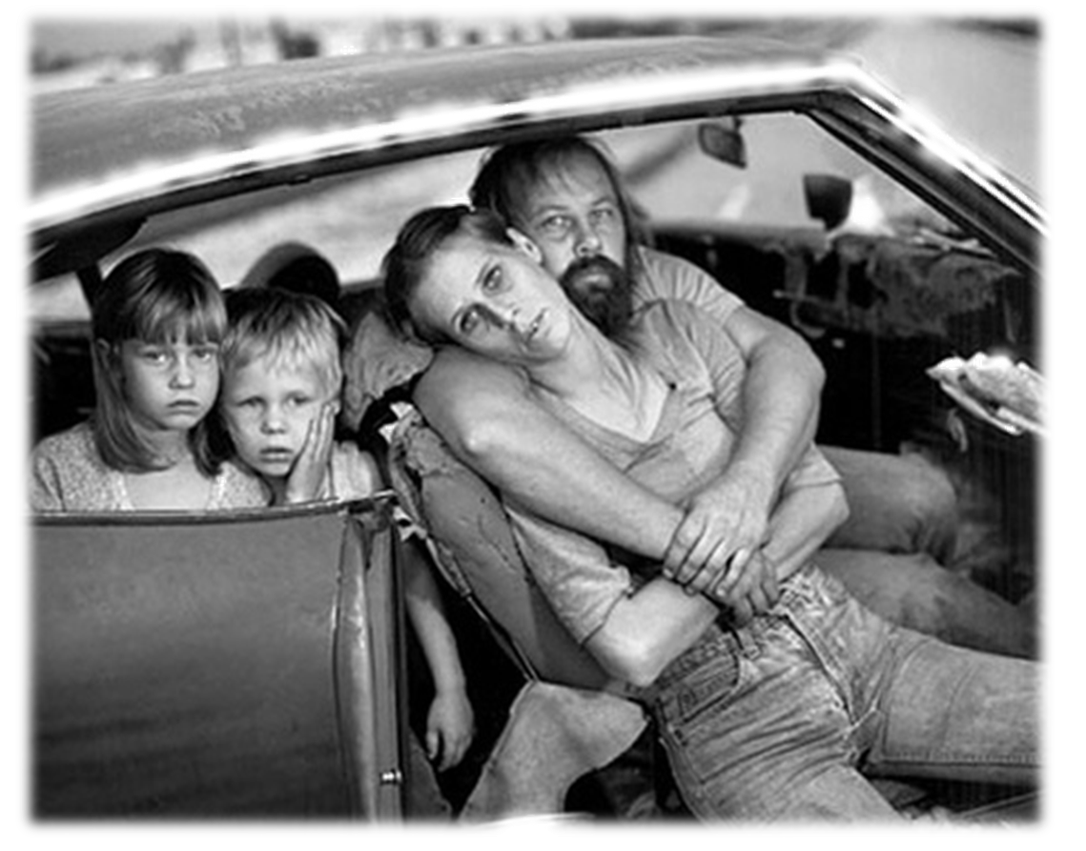
Possible Risk Factors Affecting Families
Poverty
Nonflexible work situations
No parental leave
Oppression related to race, immigration status, language, sexual orientation, gender, health status, ability, etc.
Little support from other family members or neighbors
Challenging relationships with their own families
Substance abuse
Domestic violence
Notes:
State that childrenʼs early social and emotional development depends on a variety offactors, including genetics, environment and the community. State that these influences affect development in a number of ways. Activity: Write two column headings on chart paper: Influence and Effect. Next, ask participants to think about the influences on a young childʼs development within the first 3 years and the effect these influences could have. A possible example to share would be “caring relationships” as the influence with the effect(s) as “the ability to trust” and/or “feeling of confidence.” After participants have had a moment to reflect, ask them to share their answers with the larger group. Write their responses on the chart paper. Explain to participants that risk factors are obstacles to healthy development. Highlight any examples generated by participants in the above activity. Share that protectivefactors are those things that help offset risk and young children become resilient so they can bounce back from challenges that arise. One influence on an infantʼs or toddlerʼs social emotional development is the general level of stress a family experiences and the familyʼs capacity to adapt to that stress. When there is additional stress from environmental circumstances, such as poverty or community violence, or when there are genetic factors that make caring for an infant or toddler particularly challenging, such as prematurity, developmental disabilities, or special healthcare needs, familiesʼ ability to form a relationship and provide their children with consistent, responsive care may be adversely impacted.
Read each factor aloud. Point out that those on the list are just some of the risk factors known to have a negative impact on the social emotional development of young children.

Slide 114
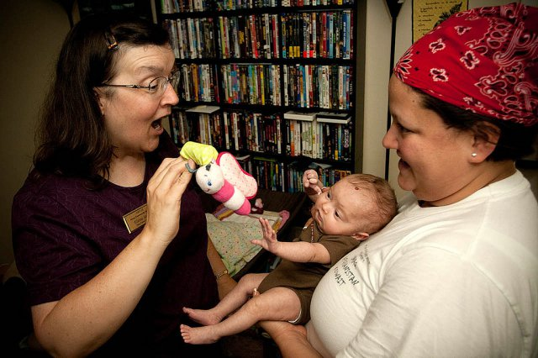
Family Coaching is……..
The importance of using effective family coaching to support the family’s capacity to promote their child’s social emotional competence.
Notes:
Read slide
3 types of support:
Emotional
Materials
Information
Comments

Slide 115
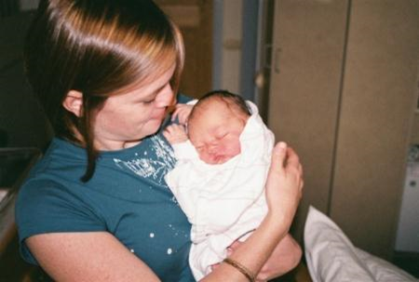
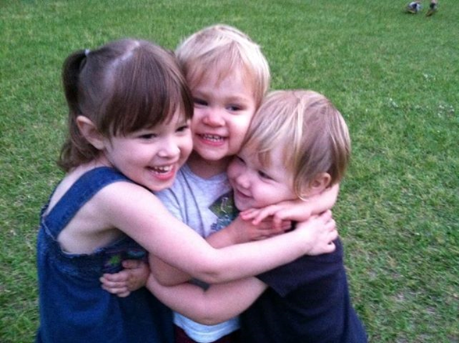
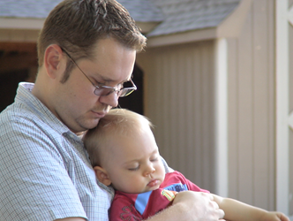
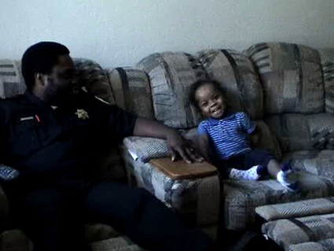
Families who face challenges with nurturing and responsive relationships and providing high quality environments are provided with resources, support, and additional services to ensure their capacity to PROMOTE social development.
Notes:
Read slide

Slide 116
Partnering with Families
ALL families can provide rich learning opportunities for their children
  Recognize families’ strengths and resourcefulness
When a parent feels secure in his/her relationship with EI staff, s/he feels more invested in the intervention (Parlakian & Seibel, 2002)
  Relationships involve a parallel process (Seibel, Britt, Gillespie, & Parlkian, 2006)
Culture impacts the parent/child/coach relationship
  Influences communication and expression of emotions
Notes:
Review each of the bullets.
Highlight the importance of using a strength-based approach when supporting families. Supportive practitioners recognize that all families have strengths and needs.
It’s important to identify and use strengths when supporting families.
Emphasize the parallel process. This means, practitioners should develop a supportive, nurturing relationship with the caregivers to provide a model for them to have a nurturing and supportive relationship with their children. Again, review the importance of culture.

Slide 117
Pyramid Model Family Modules
PIWI
POS
Parents Interacting with Infants
http://csefel.vanderbilt.edu/resources/training_piwi.html
Positive Solutions
http://csefel.vanderbilt.edu/resources/training_parent.html

Slide 118
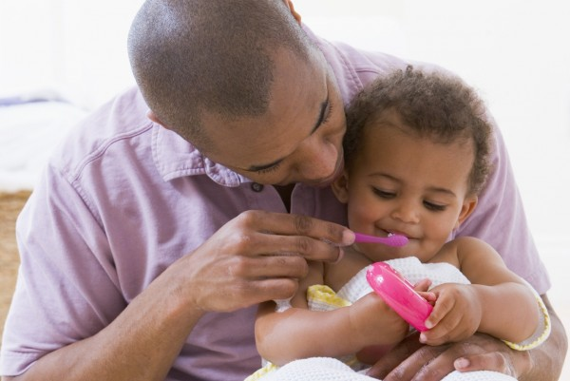

Parent Interacting With Infants:
PIWI
Notes:
And Toddlers

Slide 119
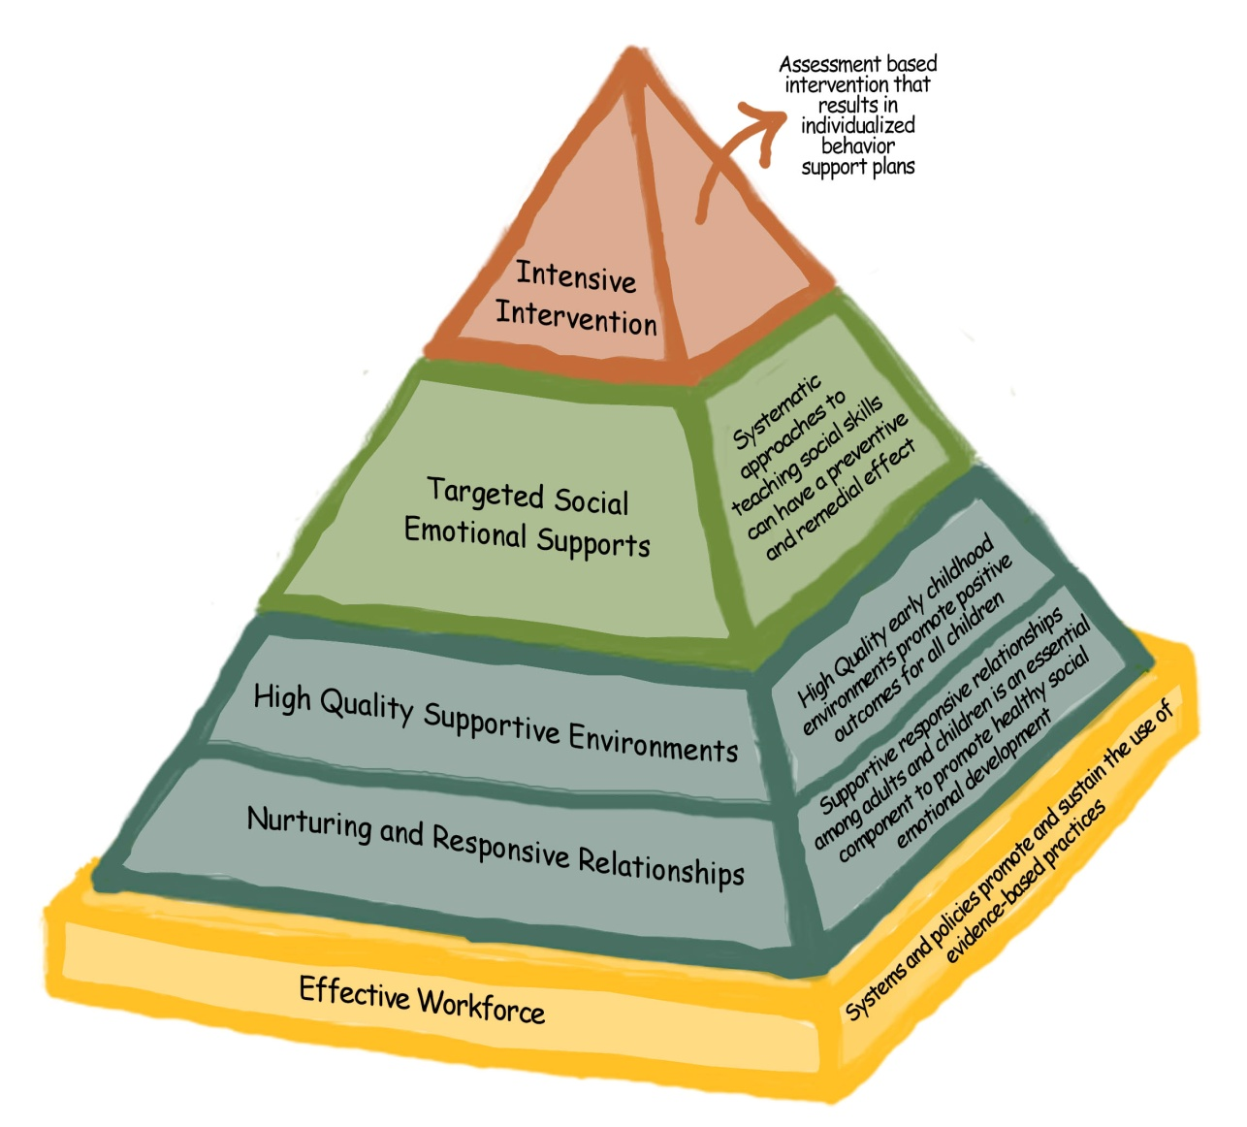
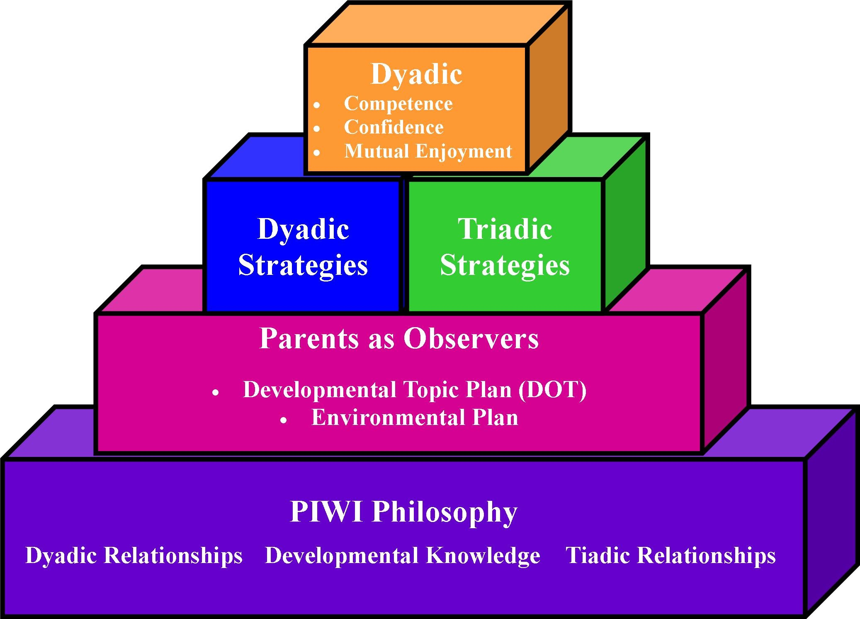
The Pyramid Model
Framework
The PIWI Building Blocks
3 KEY OUTCOMES
  Competence
  Confidence
  Mutual Enjoyment

Slide 120

PIWI Philosophy Related to Children
Early development is embedded within relationships and context of daily routines
Children are active learners
Individual adaptations are used to enhance children’s ability to engage in their environment
Notes:
The PIWI Philosophy related to children states: Read each bullet
To expand the discussion about the PIW Philosophy related to children. Think what practices are in place in each of the following:
embedded within significant relationships
daily routines
developmentally appropriate culturally appropriate
natural routines and interactions

Slide 121

PIWI Philosophy Related to Practitioners
Primary role is to support and enhance parent –child relationships
Practitioners support parent-child interactions within daily routines and supportive environments
Practitioners collaborate with team members as a resource to families and one another
Notes:
Read the bullets
To expand the conversation related to Practitioners
supportive relationships
Collaboration
active support
meaningful
Opportunities
parent-child interactions
The main idea at this point is to remember that the Philosophy is the basis for a framework that will be translated into practice. Point out that the PIWI Philosophy is equally applicable to parent-child groups and home visits. Handout PIWI

Slide 122
1 & 1 = 2
Children develop within the context of relationships
Purpose: to build relationships with parents and influence the skills of parent
Practitioner must go in thinking about how to build a strong relationship with the family
Notes:
The dyad is always at the center of our work. The focus of PIWI practices will be ways of interacting with parents to support competence, confidence and mutual enjoyment of the dyad.
The importance of building relationships with parents and caregivers influences skill building. Each family you work with will look different, however the strategies you will learn today can be used with each of those families.

Slide 123
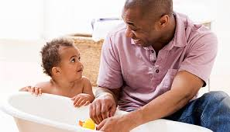
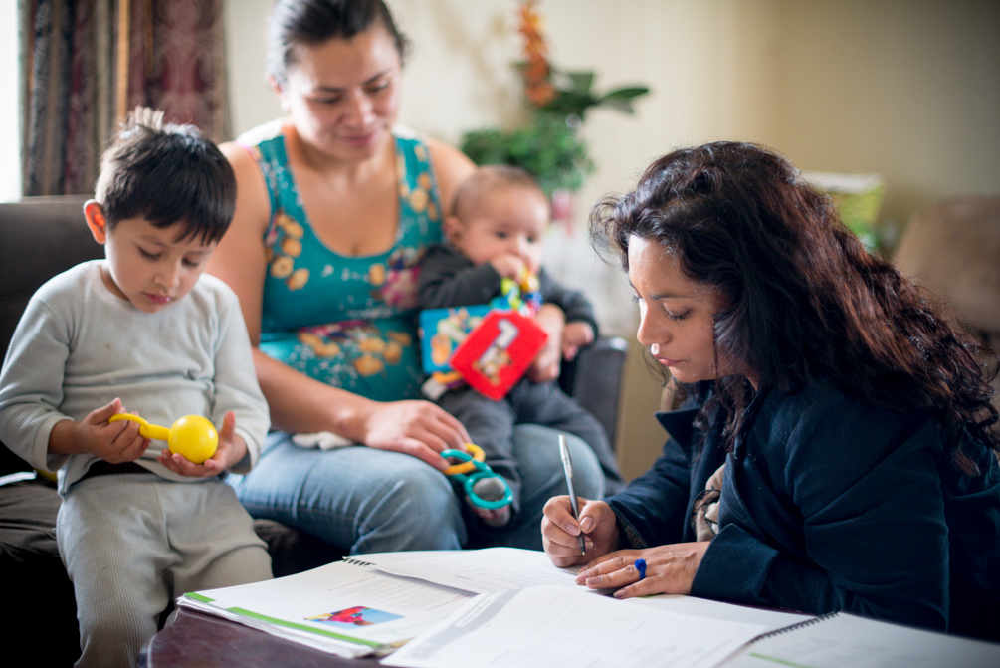
Infants and Toddlers develop and learn through meaningful everyday experiences and interactions with familiar people in familiar places.
ALL families with the necessary supports and resources can enhance children’s development and learning.
Notes:
Do you agree?

Slide 124

Dyadic Strategies
Supporting parent-child interaction for:
Competence
Confidence
Mutual Enjoyment
Notes:
We have looked at characteristics of the dyad and how the “match” may influence this relationship. It is very important for us to think about the match when we think about dyadic strategies to implement for supporting
Competence
Confidence
And Mutual enjoyment

Slide 125

PIWI Handouts
Dyadic Characteristics and Strategies
PIWI Implementation Guidelines
Notes:
PIWI W.1

Slide 126
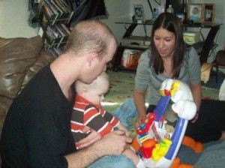
Dyadic Interactions: What adults do...
Set the stage for interaction
Maintain child’s interest and attention
Establish reciprocal roles (turn-taking)
Match and follow
Support and Scaffold Learning
Notes:
Please look carefully at the slide and try to identify what this parent is doing to support the dyadic interaction.
Activity: Discuss characteristics you would see when observing responsive, supportive parent child interactions. This slide summarizes 5 things that adults typically and very naturally do as they interact with young children in a way that helps to create a match with the child's personality, temperament, interests and needs, and thereby supporting the child's social emotional development and learning.

Slide 127
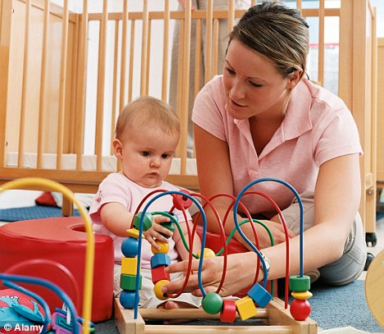
Engaging Parents and Caregivers as Observers
Notes:
Ask open ended questions.
“How do you think your child will engage with…..”
“How will your child get your attention”?

Slide 128
Dimensions of Communication
Every communicative behavior can be described by the form and function.
  Form: The behavior used to communicate
  Function: The reason or purpose of the communicative behavior
Notes:
Every communicative behavior can be described by the “form” and “function” of the communication. Review distinctions between form and function from definitions on the slide:
a. Form: The behavior used to communicate b. Function: The reason or purpose for the communicative behavior. c. Invite the group to spend some time thinking about forms of communications observable in early childhood

Slide 129

Expression of Emotion
Intensity
Frequency
Duration
istockphoto.com/Rebecca Ellis
Notes:
In addition to observing the form of communication and the interpreted function, other dimensions to consider are the intensity, frequency and duration of the communicative behavior. Ask participants for their definitions of intensity, frequency and duration with participants:
! Intensity- strength or power of the behavior ! Frequency- how often the behavior occurs ! Duration- how long does the behavior last
Write definitions on the large paper.
H. Point out that these dimensions often cue us to take note of behavior that might be typical for the child’s developmental stage – but it is the intensity, frequency, or duration that can make it confusing, worrisome, or challenging to caregivers.
Examples:
! A 3-year-old refusing lunch one day would be looked at differently than if that child refused lunch several days in a row (frequency). ! A 4-month-old who usually cries each morning for a period of 5 minutes before falling asleep, cries for an hour and does not settle to sleep (duration). ! A 2-year-old throws herself down on the floor when she sees a child holding a toy that she wants, but then jumps to her feet screaming, runs to the child with the toy and smacks the child (intensity)

Slide 130
Why Parents as “Observers”?
Benefits to Parents
Better understand what their child is like
Experience pride in what their child can do
Better understand their role in supporting their child’s development
Gain confidence in supporting their child’s development and learning
Have fun with their child!
Benefits to Children
Practice and demonstrate what they can do
Expand what they already do, know & feel
Gain confidence and fee good about themselves
Have fun with their parent(s)!

Slide 131

Parents as Observers
Why Focus?
Focusing Better Observations
Better Interpretations More Accurate Interpreters
Sensitivity & Responsiveness
Better Supporters of Child’s Development
Notes:
Think back to when you first started learning about child development. That was a lot of information to learn and understand! But, the more opportunities you had to observe children and the more you saw development in “action” - the easier it probably was for you to understand, interpret and support development!

Slide 132


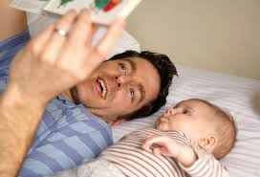
What I’m Like
How I communicate my needs
How I explore my environment
How I’m comforted
How I interact with others
How I …….
Notes:
PIWI Handout 8

Slide 133
Parents as Observers in All Settings
Home Visiting programs
Parent-child groups
Center based
Family child care
Parents as first teacher
Parents as partners
Parent as interpreters of their child’s behavior
Parent and child as life long learners
Notes:
When we engage the parent as observers, it is from the perspective of the child.
“How I ….” is a topic that helps parent organize their observation.
Developmental Observation Topics (DOT) can be linked to IFSP & IEP goals

Slide 134

Positive Solutions POS:
A Parenting Support Group
Modules include:
(1) Making Connection! (2) Making it Happen! (3) Why do Children Do What They Do? (4) Teach Me What To Do! (5) Facing the Challenge (Part 1) (6) Facing the Challenge (Part 2), a Family Workbook, and a Facilitators Guide.
Notes:
The Center on the Social and Emotional Foundations for Early Learning (CSEFEL) has developed an evidence-based, user-friendly parent training series of six sessions to help professionals working with parents promote positive and effective parenting behaviors, which will in turn promote children’s social and emotional development and address the challenging behavior and mental health needs of children.
The training materials provide information for families on how to promote children’s social and emotional skills, understand their problem behavior, and use positive approaches to help children learn appropriate behavior. The trainings are designed to give parents general information on key strategies that may be used with all children.

Slide 135
Relationship Activity
Workbook Activity #1
Think of someone who was really special to you when you were growing up.
What made you think of this person?
What did they do that made them important or special to you?
Notes:
Example of parent activity
Small group activity “What about you?”
Report back to group

Slide 136
Giving Directions
Give directions that are positive.
Give children the opportunity to respond to a direction.
When appropriate, give the child choices and options for following directions.
Follow through with positive acknowledgment of children’s behavior.
Notes:
Parent communication

Slide 137
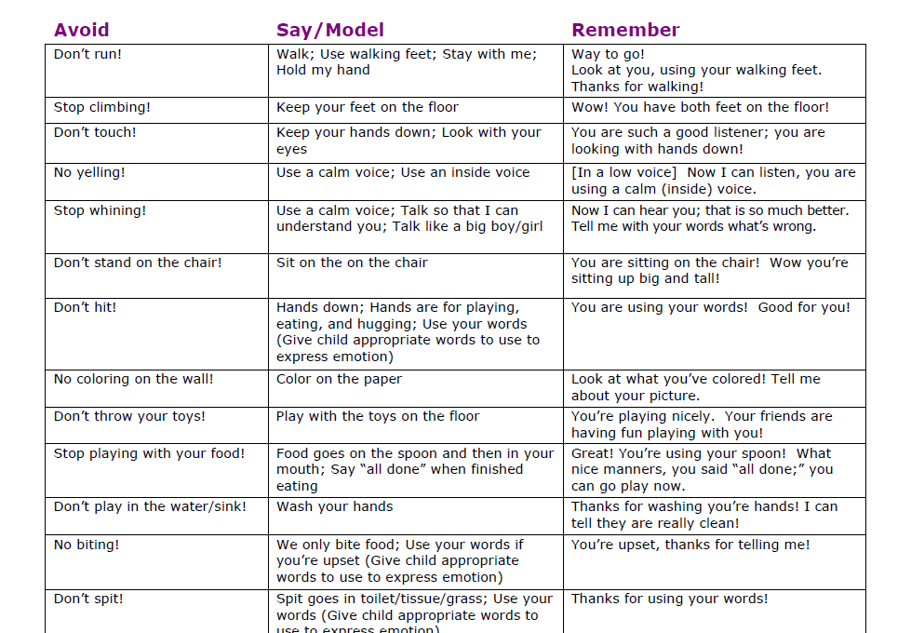

Slide 138
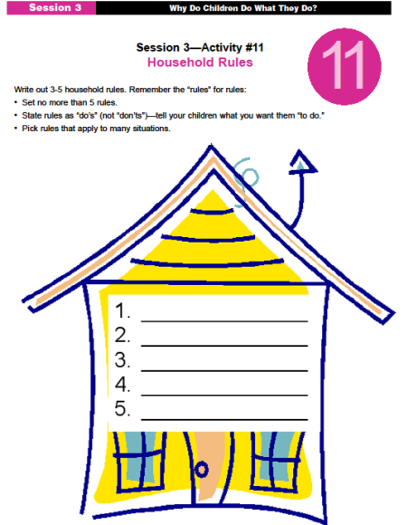
Partnering With Families
Household Rules
Encourage families to create household rules.
Help them make rules that teach their children what TO DO.
Provide strategies to use for teaching and reinforcing the rules.
Notes:
Activity that can also be done during a home visit

Slide 139
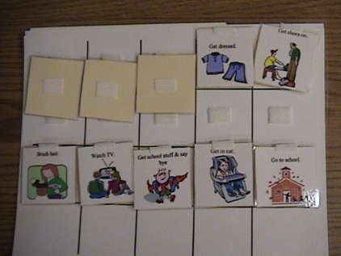

Partnering With Families
“Getting Ready for School” Visual
  Helps families prepare child for leaving home and going to school.
  Provides predictability with a “schedule” of clear expectations around the morning routine.
Notes:
Visual schedules can also be useful for families. This slide illustrates a visual schedule that might be used by the family to help their child with the getting ready for school routine. The pictures used in this schedule are available in the Teaching Tools for Young Children product on www.challengingbehavior.org

Slide 140
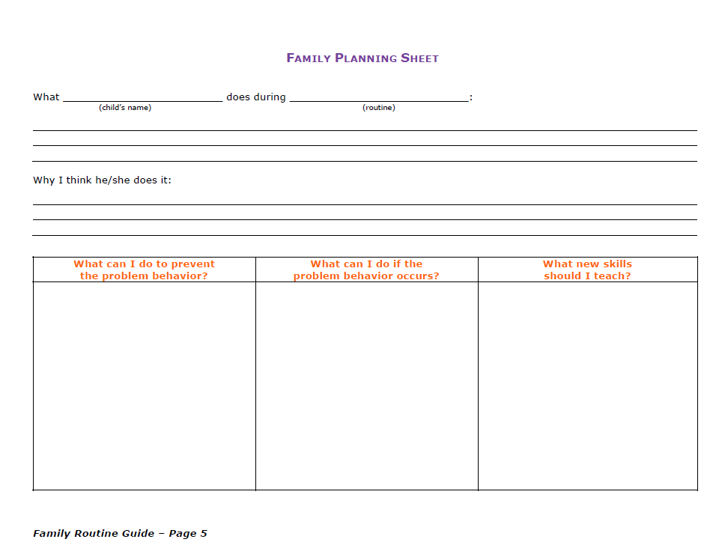

Slide 141
Small Group Activity
Each group will take one routine from the Family Routine Guide and review the chart for that routine.
The group will then discuss how this chart could be used or adapted for use in systems of care.
Notes:
Handout Family Routine Guide activity page

Slide 142
Video 2.5 Responsive Routine Based Interactions
Notes:
Recap some of the strategies observed in the video, emphasizing the power of play in building positive relationships (e.g., talk to children about things they do at home or in other settings during play, actively engage in children’s play, participate as a play partner, sit at children’s level, joke and laugh with children, spend time with children doing what they love to do).
Discuss that research supports the importance of providing a high ratio of positive and encouraging statements to those that might be corrective or perceived as negative. Research supports that the ratio should be 5 positive statements for every 1 negative. When teachers are more mindful of the need to increase the number of positive statements the emotion

Slide 143
Positive Adult-Child Interactions
Acknowledge child’s communication (verbal or non-verbal)
Greets children by their name
Engage in one-to-one interactions, at eye level
Use a voice that matches the child’s temperament and simple language
Provide warm, responsive physical contact
Follow the child’s lead and interests during play
Listen to children and encourage them to listen to others
Acknowledge child’s accomplishments & efforts
Notes:
Share these slides to provide examples of positives that are deposits in the relationship with the child.

Slide 144

Building Positive Relationships by Making Deposits
Maintain a 5:1 (positive to negative)
Give attention when the child is engaged in appropriate behaviors
Notes:
How do we build relationships with children? Present the metaphor, adopted from the work of Carolyn Webster-Stratton, of a “piggy bank” to illustrate “making deposits into children’s emotional banks” as a way of building positive relationships (Webster-Stratton, 1999). • Instead of a piggy bank, other metaphors might be a garden (growing) or basket (filling). Ask participants to generate other possible metaphors. We make deposits when we do things to build relationships while we make withdrawals when we engage in behaviors that are detrimental to relationship building.
Video 1.1
• Recap some of the strategies observed in the video, emphasizing the power of play in building positive relationships (e.g., talk to children about things they do at home or in other settings during play, actively engage in children’s play, participate as a play partner, sit at children’s level, joke and laugh with children, spend time with children doing what they love to do). • Discuss that research supports the importance of providing a high ratio of positive and encouraging statements to those that might be corrective or perceived as negative. Research supports that the ratio should be 5 positive statements for every 1 negative. When teachers are more mindful of the need to increase the number of positive statements the emotional warmth of the classroom shifts to become more positive.

Slide 145
It All Adds Up
Deposits:
  Active Listening
  Wait Time
  Observation
  Mirroring
  Self Talk
  Parallel Talk
  Reflection
  Expansion
  Modeling
Withdrawals:
  No
  Don’t
  Stop
  Demands - directions
  Using a loud voice
  Intimidating request

Slide 146
Building Positive Relationships with All Children
How do your deposits change when the child:
Does not respond to your attention?
Cannot see or hear you?
Relies on others for mobility?
Has serious medical concerns?
Notes:
146

Slide 147
The Benefits!
Influence a child’s emotional, cognitive, and social development
Help children develop secure relationships with other adults
Help children develop good peer relationships
Help reduce the frequency of behavior problems
Help children develop positive self-esteem
Results in higher rates of child engagement
Notes:
Summary on the benefits of deposits in the relationship with the child.

Slide 148
Making Deposits: Families
How do you make deposits with families?
  Are you personally connected to them?
  Do they know a little bit about what is happening in their lives on a daily basis?
  Do they have information from you for promoting their child’s social emotional development at home?
Notes:
Ask the questions on slide with the participants. Write their ideas about how to make deposits with families who are difficult to reach on chart paper.

Slide 149
Making Deposits: Team
How do you make deposits with your team?
  Daily check-ins
  Sharing “success stories” during team meetings in addition to focusing on challenging issues
  Supporting team members’ knowledge of one another’s lives/families
Notes:
Ask participants to reflect on the importance of deposits with your team.

Slide 150
Make-and-Take Team Activity
Filling the Team Piggy Bank
What deposits are already in your team’s bank?
What deposits are in progress?
Create coins to represent each.
Notes:
Templates

Slide 151

Children with a Strong Foundation in Emotional Literacy
Tolerate frustration better
Get into fewer fights
Engage in less destructive behavior
Are healthier
Are less lonely
Are less impulsive
Are more focused
Have greater academic achievement
Notes:
Handout: Examples of SE books
Helps children better understand life experiences
Provides insights into human behaviors, emotions, dilemmas
Stimulates curiosity
Develops problem-solving skills
Informs with facts, concepts, new understanding, demystifies
Provides comfort
Models coping strategies by walking readers through possible solutions or ways to cope

Slide 152
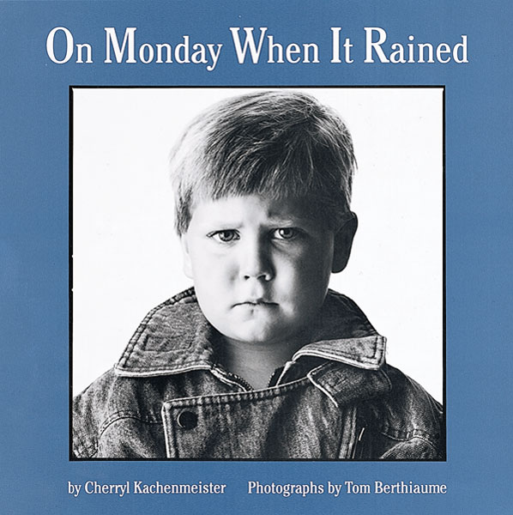
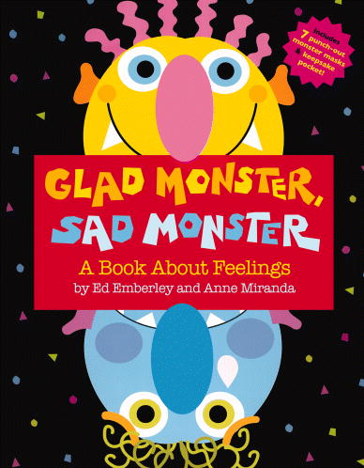

Book Nooks http://www.csefel.uiuc.edu/practical-ideas.html
On Monday When
It Rained
Glad Monster
Sad Monster
Hands Are Not for Hitting
Notes:
How can you use books in your work?

Slide 153


CSEFEL Resources
Available on http://csefel.vanderbilt.edu/

Slide 154

TACSEI Resources
Available on www.challengingbehavior.org

Slide 155
Notes:
Homework check-in
What did you learn?

Slide 156
Resources
Early Childhood Mental Health FUN KIT
Engaging Activities for Children and Caregivers
http://www.ecmhmatters.org/ForFamiliesAndFriends/Pages/ForFamiliesAndFriends.aspx
Notes:
ECMHM Fun Kit for parents

Slide 157
Major Messages
The first and most important thing that we can do is to build positive relationships with the people we work with—children, families, coworkers.
We can focus on prevention and facilitating the learning of social-emotional skills to reduce the likelihood that children will require more intensive services down the road.
Promoting social emotional development is not easy. There are no quick fixes to challenging behavior. Solutions require self-awareness, reflection, and an ability to understand the meaning behind behavior.
This work requires a comprehensive approach that includes all members of the team.

Slide 158
Questions
What questions do you have about the material we discussed?
What insights if any do have about your own practices, the children, and/or their families?
What strategies did you see or hear that might be useful in your role and work?

Slide 159
Evaluations

Slide 160
Foundations of the CSEFEL Pyramid Model http://connectedbeginnings.org/foundations-csefel-pyramid-model-course-materials/
Early Childhood Mental Health Matters http://www.ecmhmatters.org/Pages/ECMHMatters.aspx
http://www.ecmhmatters.org/ForFamiliesAndFriends/Pages/ForFamiliesAndFriends.aspx
Project LAUNCH SAMSHA http://www.healthysafechildren.org/grantee/project-launch
CSEFEL Pyramid Modules
http://csefel.vanderbilt.edu/resources/training_infant.html
http://csefel.vanderbilt.edu/resources/training_preschool.html
http://csefel.vanderbilt.edu/resources/training_piwi.html
http://csefel.vanderbilt.edu/resources/training_parent.html

