Slide 1
Massachusetts Pyramid Model 5th Annual Summit:
State of the State 2017

Slide 2
Phases of Mass. Pyramid work
CSEFEL Pyramid State Roll out (2009-2013)
Trained trainer and coaches, 3 ECE demo sites, program wide training, data collection, family modules training
Making the Pyramid our Own
Blended B-5 approach, created Foundations of the Pyramid and Top of the Pyramid Skills, adapted coach training and train trainer, convened annual Summit
Spreading and Scaling
Master Cadre, ECE implementation sites, ECE program wide sites, homeless shelter project, higher ed institutes
Bridging Across Systems
Dept. Elementary and Secondary Ed. (ESE) State Systemic Improvement Plan (SSIP), Early Intervention SSIP;
Pyramid Model Learning Communities;
Inclusive Pyramid Demonstration sites

Slide 3
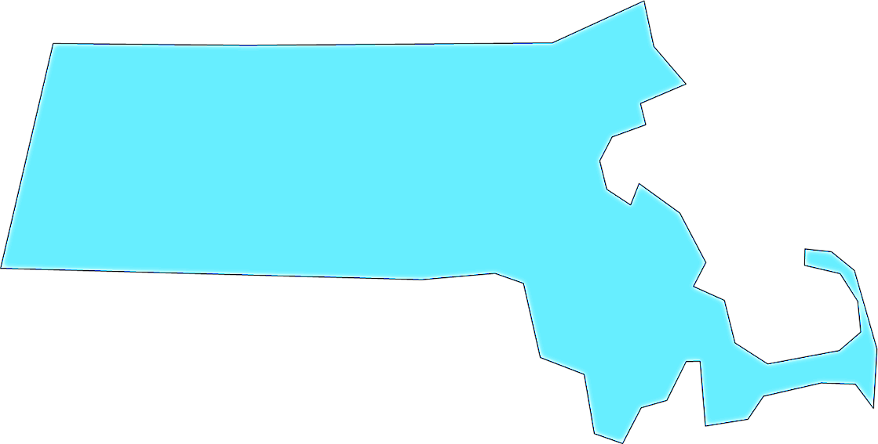
Massachusetts Pyramid Model Training with Target Audiences
Early Education & Care, Public Preschool Special Education, Early Intervention Practitioners
Infant/Toddler and Preschool Modules
Foundations of the Pyramid Model
Mental Health Consultant, Early Education Administrator & Teacher Teams
Top of the Pyramid Skills (TOPS)
Parents Interacting with Infants (PIWI)
Early Intervention, Mental Health Consultants, Family Support, Home Visiting, Primary Care Behavioral Health Integration Teams
Positive Solutions: Family Modules
Shelter staff: Administrators, Floor Staff & Mental Health Clinicians
Positive Solutions for Powerful Family Interactions
ECE Program Teams implementing to fidelity
Adopting the Pyramid Model Program-Wide
Mental Health Clinicians & Administrators
Pyramid Coach's Training
Teaching staff at 2 & 4 year institutions
Pyramid Higher Ed Institute
Notes:
Lowell

Slide 4
Overview - Building State Infrastructure
Building State Infrastructure
Build community implementation
Pyramid State Leadership Team coordination
Coordinate interagency efforts to support families
Data collection and longitudinal data systems
Coordinated grant programs
Using Implementation Science - depth over breadth

Slide 5
Exciting New Developments

Slide 6
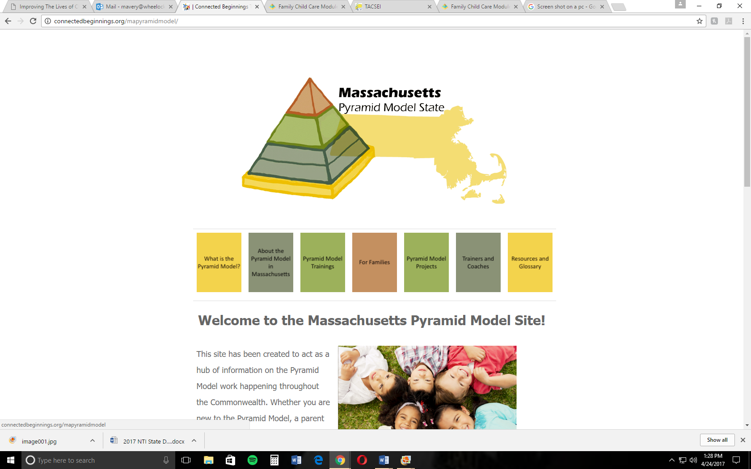
Our New Mass Pyramid Website!! http://connectedbeginnings.org/mapyramidmodel/

Slide 7
http://connectedbeginnings.org/mapyramidmodel/resources/

Slide 8
Pyramid Model Learning Communities
Our 4th round of PMLCs will be in May in Springfield, Boston, Lawrence, Worcester and Taunton
Facilitated by a set of trained Pyramid external coaches
PMLCs helped identify training needs for 3 initial regions: Boston/Metro—Program Wide (completed last fall), Worcester—Positive Solutions and Springfield—Foundations, both planned for this summer
Needs identified: funding, training, getting everyone to the table/collective impact, staff retention & skill level
Behaviors/trends observed: parental red flags/lack of engagement; child neglect/basic needs; child aggression, distractibility, low tolerance for frustration; child and parent trauma
Notes:
s
Announcing Registration for:
The Pyramid Model Learning Community
Focus on: Using Routine-Based Opportunities to Practice New Skills
Routines that occur within natural environments for young children provide the most effective framework to support and sustain intervention activities. When a child is familiar with routines, caregivers can focus on scaffolding new and more complex learning based on those experiences. Please join us for a discussion on routine -based interventions.
Springfield EEC Office
1441 Main Street, Suite 230
Springfield, MA 01103
Date: 5/9/17
Time: 1:00-3:00pm
Click HERE to register for Springfield.
Boston: Wheelock College
43 Hawes Street
Brookline, MA, 02446
Date: 5/16/17
Time: 1:00-3:00 pm
Click HERE to register for Boston
Lawrence EEC Office
360 Merrimack Street, Building 9,
Third Floor
Lawrence, MA 01843
Date: 5/15/17
Time: 10:00-Noon
Click HERE to register for Lawrence.
Worcester Public Library
Banx Room, Main Branch
3 Salem Square
Worcester, MA 01608
Date: 5/23/17
Time: 10:00-Noon
Click HERE to register for Worcester.
Taunton EEC Office
1 Washington Street, Suite 20
Taunton, MA 02780
Date: 5/17/17
Time: 1:00-3:00 pm
Click HERE to register for Taunton.

Slide 9
Inclusive Demonstration sites
3 sites will be selected to receive training and coaching on the Pyramid Model to support inclusion of children with disabilities.
8 sites were recommended by Pyramid coaches and trainers based on their commitment, leadership, and readiness to embark on this journey.
Initial focus will be 1 classroom receiving coaching support.
On-site coaching will include:
observation of current practices, help to develop an action plan, training in the Pyramid, and coaching to support implementation of teaching practices with enough intensity and focus to make a change.
Site Leadership Team will examine policies and practices so that efforts are streamlined, supported, and sustained.

Slide 10
Shelter project paper

Slide 11
Partnerships

Slide 12
Department of Elementary and Secondary Education (ESE)
ESE is working intensively with 19 public school districts representing almost 30% of the state public preschool population to support program wide implementation of the Pyramid Model.
Training for district leadership teams, coaches, and teachers supports depth and spread of implementation in these districts and their community partners.
ESE is also supporting the use of Positive Solutions in these districts and their community partners.
ESE is funding an Interagency Agreement with DPH to support the Summit, PMLCs, State Leadership Team, and the Inclusion Demo sites.

Slide 13
Department of Early Education and Care (EEC)
EEC and ESE are hosting a two-part series on “Positive Solutions for Families”. It will highlight content from each of the 6 modules and resources to support educators working with families. Community teams will develop plans and learn strategies on how to engage families using these modules to support families, communities and school connections. Tweety Yates is the presenter.
EEC is conducting communities of practice meetings on the preschool modules for the mixed delivery system in MA.
EEC’s Educator and Provider Support grantees (EPS) professional development opportunities include CEU-bearing Pyramid Model trainings for community and public early care and education programs.

Slide 14
Department of Public Health (DPH)
DPH manages the ESE Interagency Agreement activities
DPH’s Massachusetts Early Intervention (EI) system has a a state-wide initiative to embed principles from the Parents Interacting with Infants (PIWI) approach to working with families during home visits. This is one strategy of the State Systemic Improvement Plan (SSIP) to address Social Emotional skills in children enrolled in EI. EI has a cadre of trainers, a Pyramid Foundations online module for all EI providers, and training for all EI providers statewide on the PIWI philosophy and following up coaching at all programs.
Project LAUNCH Expansion grant funds supported piloting of the Pyramid Model Learning Community in three regions of the state, and funded start-up of the MA Pyramid Model website

Slide 15
Head Start and Early Head Start
UMass Donahue Institute’s Regional Head Start TTA Network worked with 3 Head Start grantees in their implementation of the Pyramid Model approach in their infant-toddler programs. They also sponsored two cohorts at Institutes on Systems for Social Emotional Wellness, which gave teams an opportunity to use the Pyramid Model as a framework for revising program systems, policies and practices to improve their support of social emotional wellness for children, families and staff.
Worcester Community Action Council (WCAC) participated in Program Wide Roll-out training and PIWI for their EHS groups and home visiting.
Haverhill Community Action, Inc. (CAI) is exploring the Pyramid adoption for HS & EHS.

Slide 16
Connected Beginnings
CBTI has trained thousands of early childhood professionals in a variety of roles on all levels of the Pyramid Model. Since April 2016, CBTI has trained over 500 early childhood professionals.
CBTI continues to offer training and TA to support the Pyramid Model efforts in Connecticut, primarily with the Solid Ground Project.
CBTI has led the development, launch, and maintenance of the new Massachusetts Pyramid Model website. The website will provide the Commonwealth with a much-needed hub of information on all the exciting things going on with the Pyramid Model across the state.
CBTI also assisted in the creation and delivery of 11 Pyramid Model Community of Practice (PMLC) meetings in 5 different regions of Massachusetts. The PMLCs provide opportunities for communities to coordinate their efforts related to the Pyramid Model, build capacity, and learn about resources.

Slide 17
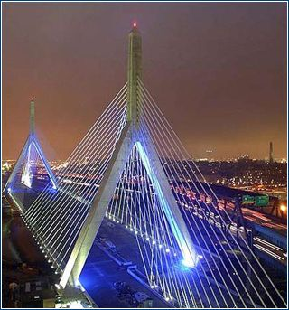
Thank You for Joining with Us!

