Slide 1
Content at Each Level of the Pyramid
Mary Watson Avery

Slide 2
The Pyramid Model: Promoting Social Emotional Competence in Infants and Young Children
Few Children
Treatment
Assessment-based interventions result in individualized behavior support plans.
Children At-Risk
Prevention
All Children
Universal Promotion

Slide 3
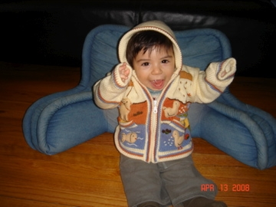
Key Points about the CSEFEL Pyramid Model
Most social/emotional development and behavior is promoted through positive preventive measures
Most children’s behavior and development does not require intensive intervention
Shared by Miriam Santiago

Slide 4
The Goal of the Pyramid is to Promote Children’s Success By:
Creating an environment where EVERY child feels good about coming to school.
Designing an environment that promotes child engagement.
Focusing on teaching children what TO DO!
Teach expectations and routines.
Teach skills that children can use in place of challenging behaviors.
PS Module 1.5

Slide 5
How Can We Get There?
Capacity to:
Feel confidence/ competence
Develop relationships
Make friends
Persist
Follow directions
Be emotionally literate
Manage emotions
Be empathetic
Capacity to:
Form relationships
Express emotions
Self-regulate
Explore with security
Develop “emergent” emotional literacy
Birth
Five
5

Slide 6
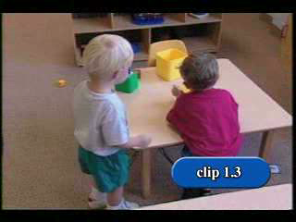
Video 1.3 What Is The Biting Trying to Tell Us?
Notes:
Use of video… talk about challenges –road blocks – do you like to use video? Why or why not?
Does video help us meet learning objectives? What about pace?

Slide 7
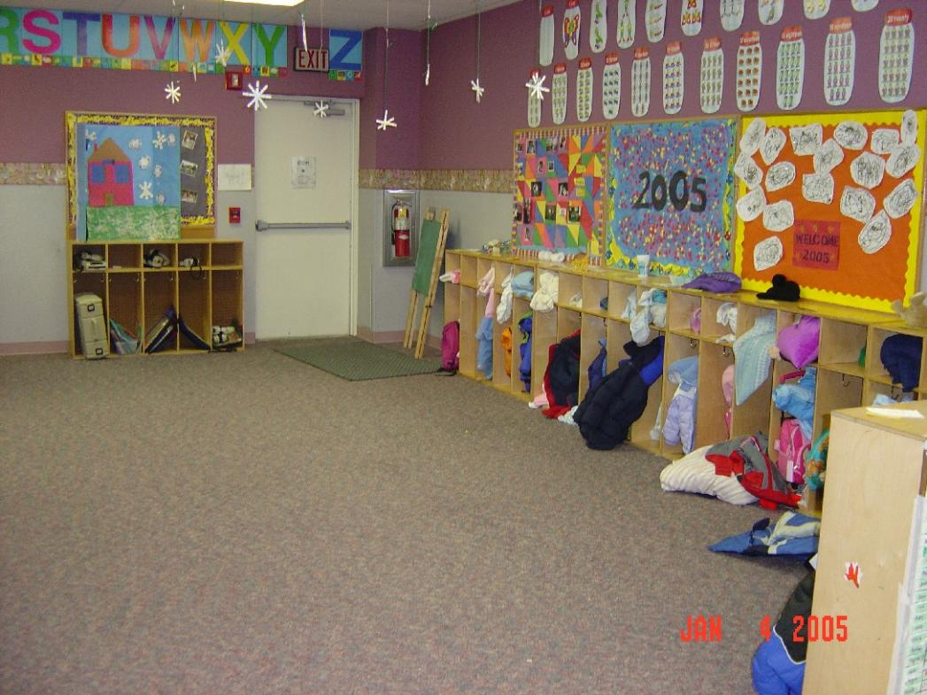
What is This Environment Telling Children to Do?

Slide 8
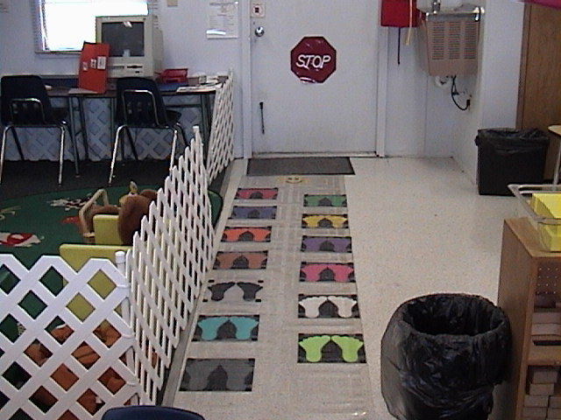
What is This Environment Telling Children to Do?

Slide 9
Stages of Learning
Show and Tell
Acquisition: new skill or concept
Practice Makes Perfect
Fluency: the ability to immediately use the skill or concept without a prompt
You Got It!
Maintenance: continuing to use the skill or concept over time
Generalization: applying the skill or concept to new situations, people, activities, ideas, and settings

Slide 10
Pyramid Model Definition of Challenging Behavior
Any repeated pattern of behavior that interferes with learning or engagement in pro-social interactions with peers and adults
Behaviors that are not responsive to the use of developmentally appropriate guidance procedures

Slide 11
Process of Positive Behavior Support
Step 1: Establishing a collaborative team and identifying goals
Step 2: Gathering information (functional assessment)
Step 3: Developing hypotheses (best guess)
Step 4: Designing behavior support plans
Step 5: Implementing, monitoring, evaluating outcomes, and refining plan in natural environments

Slide 12
Support Planning Chart
Triggers | Challenging Behavior | Maintaining Consequences
 | Form Function
Prevention | Positive Behavior | New Responses
 | New skills | Challenging Behavior New Behavior

Slide 13
Engaging Families in the Process
Step 1: Getting Ready – Families as Partners
Step 2: Goal Setting and Data Collection – Families as Consultants
Step 3: Data Assessment – Families as Informants
Step 4: Intervention – Families as Teachers
Step 5: Using Data and Next Steps – Families as Collaborators
Dunlap, Wilson, Kelly, Strain & Lee (2013)

Slide 14
References & Resources
Center on Social Emotional Foundations of Early Learning (CSEFEL) Websitehttp://csefel.vanderbilt.edu/
Dunlap, G., Wilson, K., Strain, P.S., & Lee, J.K. (2013). Prevent-Teach-Reinforce for Young Children: The Early Childhood Model of Individualized Positive Behavior Support. Baltimore, MD: Paul H. Brookes Publishing.
Hanson, M.J., & Lynch, E. W. (2013). Understanding Families: Supportive Approaches to Diversity, Disability, and Risk. Baltimore, MD: Paul H. Brookes Publishing.
Technical Assistance Center on Social Emotional Intervention (TACSEI) Websitehttp://challengingbehavior.org/

Slide 15
Thank You!
Contact information:
Mary Watson Avery
mavery@wheelock.edu
www.connectedbeginnings.org

