Slide 1
Preparing Pre-service Teachers to Support Children’s Social Emotional Development and Address Challenging Behaviors
Angel Fettig, Ph.D.
CSEFEL Pyramid Model Higher Education Institute

Slide 2
Why teach social emotional development?
Teachers reported not using effective strategies or receive limited support to address challenging behaviors.
Teachers viewed challenging behavior as having an adverse effect on them and their students.
Teachers want more training to address challenging behaviors.
(Westling, 2010; Health Care Exchange, undated)

Slide 3
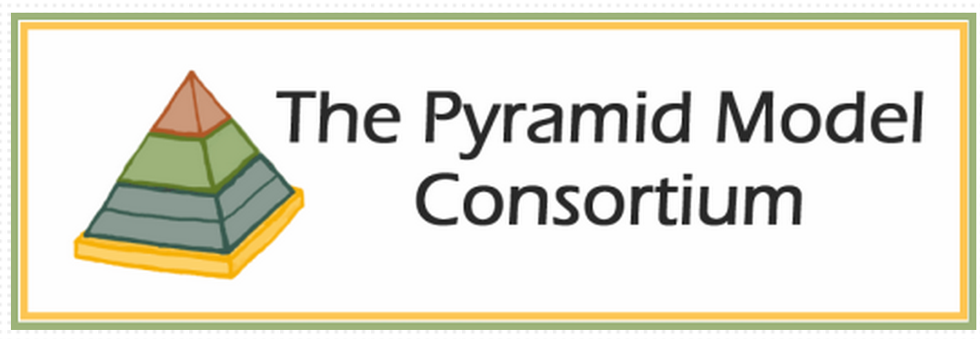
Timeliness
Roll out of Social Emotional Learning Standards
Pyramid Model State

Slide 4
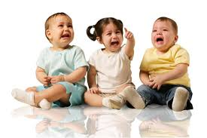
Do teachers know how to address challenging behaviors?

Slide 5
Text Books
Bullard, J. (2014). Creating Environments for Learning: Birth to Age Eight. Second
Edition. Columbus, OH: Merrill. (ISBN: 0-13-286754-0)

Slide 6
Text Books
Kaiser, B., & Rasminsky, J. (2011). Challenging Behavior in Young Children:
Understanding, Preventing, and Responding Effectively. Third Edition. Boston:
Allyn & Bacon. (ISBN 0-13-215912-0)

Slide 7
Course
ECHD 221 - Supporting Young Children’s Social Interactions & Emotional Growth
Sophomores & Juniors
3 credits
1hr 15 minutes 2x/week or 2hr 45 minutes 1x/week

Slide 8
Topics
What is Social Emotional Development
Developmentally Appropriate Practice & Standards
Building Relationships
Creating Supporting Environment
Teaching Social and Emotional Strategies
Functional Behavior Assessment & Behavior Support Plan
Classroom Behavior Management Strategies
Family and Community Involvement
Inclusion

Slide 9
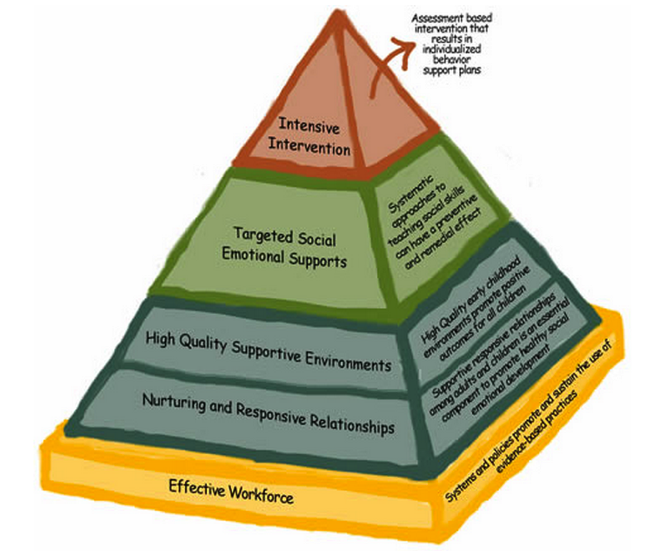
2 weeks
3 weeks
4 weeks
2 weeks

Slide 10
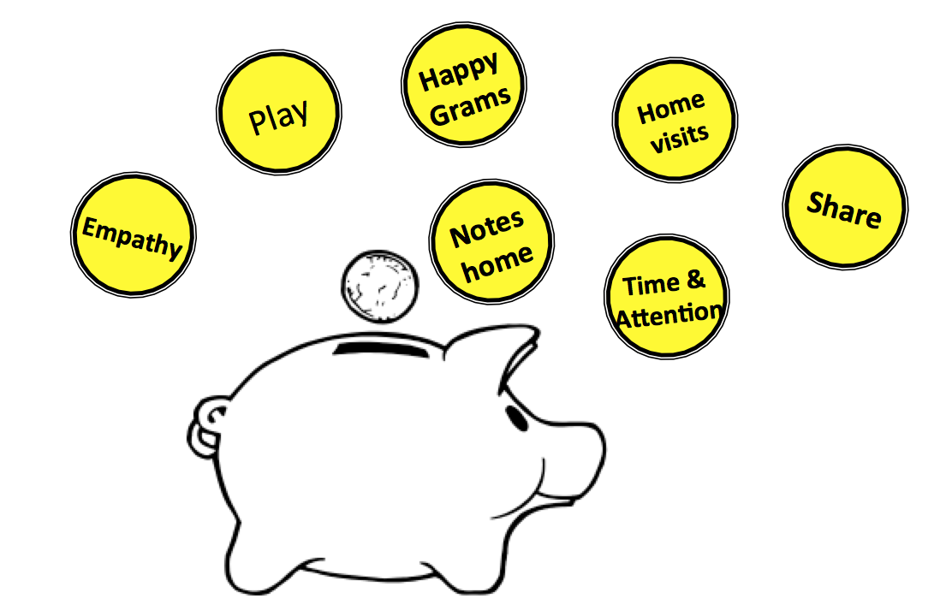
Building Relationships
Children, Families, Coworkers
Why, When, How
Behavior & Culture
What other courses can you embed these topics?

Slide 11
Sample Activity
What does it look like – TPOT video observation

Slide 12
Creating Supportive Environment
Importance
Universal Design for Learning
Engagement
Setting up Learning Centers
Schedules & Routines
Transitions
Rules & Expectations
What other courses can you embed these topics?

Slide 13
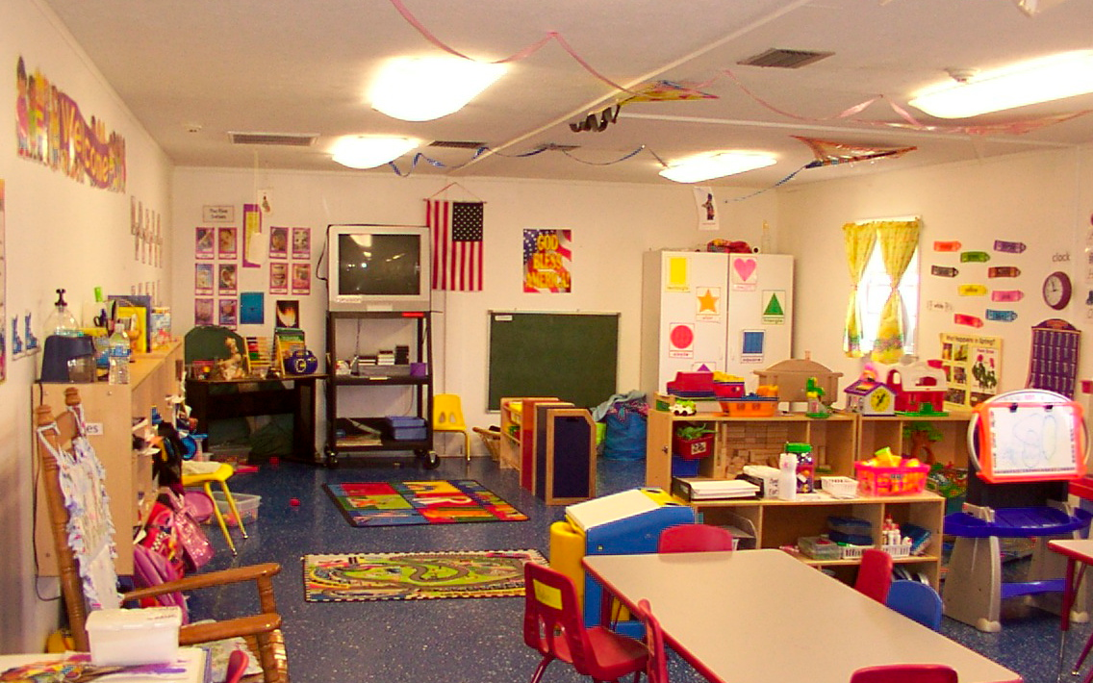
Sample Activity
Critiquing Classroom Setup/Environment

Slide 14
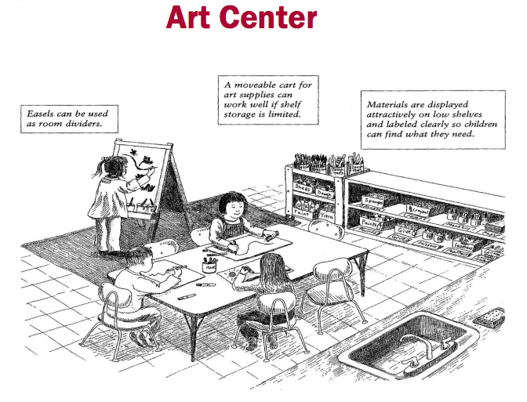
Sample Activity
Design a Learning Center

Slide 15
Sample Activity
Your school district has done poorly on standardized tests. They are now considering cutting outdoor time to allow more time for academics. Write a short letter to your school district, providing explanations on why outdoor time should not be cut.

Slide 16
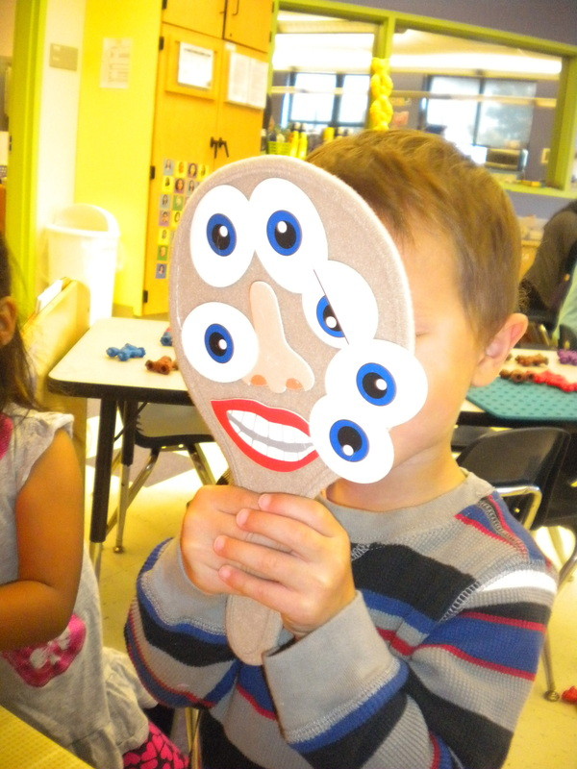
Teaching Social & Emotional Skills
Friendship Skills
Emotional Literacy
Empathy & Emotion Management
Using Children’s Books to Teach Social Emotional Skills
What other courses can you embed these topics?

Slide 17
Sample Activity
Use sticky notes and write down questions/comments to support
Emotional Vocabulary
Friendship skills
Problems solving skills
Create an extension activity
that supports children’s
social emotional development

Slide 18
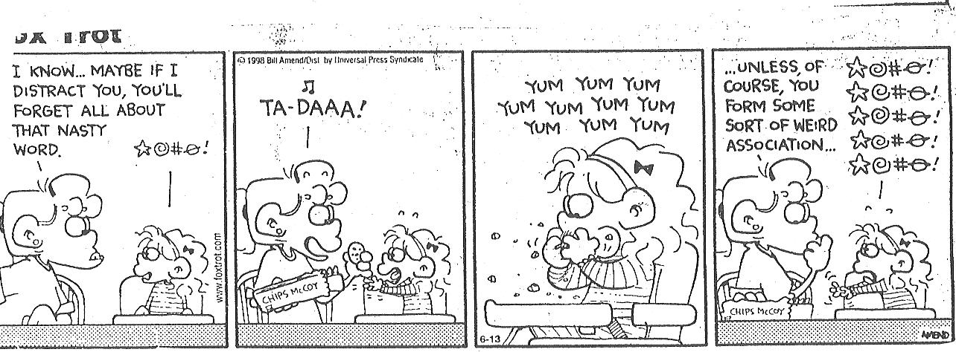
Functional Assessment & Behavior Support Plan
4 Processes of Positive Behavior Support
Antecedent-Behavior-Consequence
Identifying Function/Purpose of Behavior
Components of Behavior Support Plan
What other courses can you embed these topics?

Slide 19
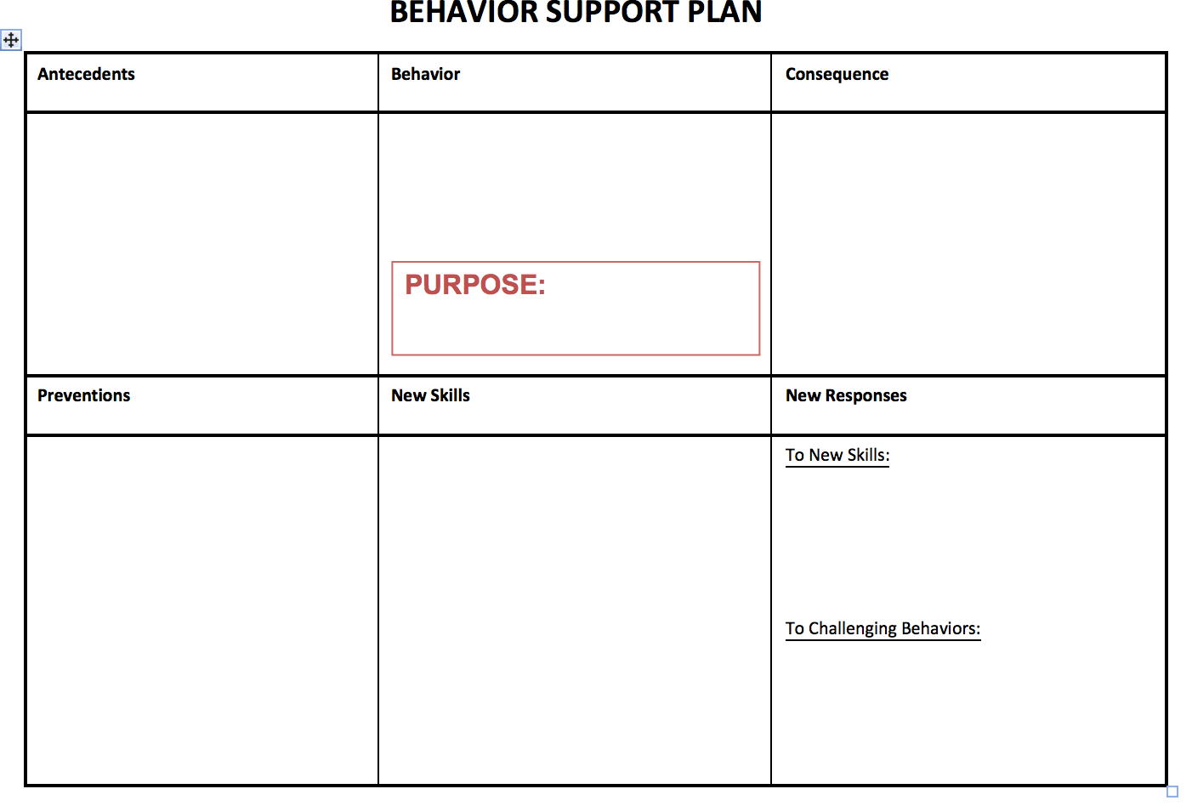
Sample Activity

Slide 20
Assignments
Environmental Observation Reflection
Classroom Behavior Management
Social Emotional Lesson Plan

Slide 21
Sample Assignment

Slide 24
Challenges
Experiences
Believes around discipline
Course sequencing
Assessing practice

Slide 25
Questions

Slide 26
Contact
Angel Fettig, PhD
Early Childhood Education
University of Massachusetts Boston
College of Education and Human Development
(617) 287-6394
angel.fettig@umb.edu

